Slide 1
2019
19
C
Canadian
Media
Usage
STudy
M
U
ST
French Canada
Rob Young
PHD Canada, November 2019

Slide 2








Stories

Slide 3
Raptors
Diversity
Stories

Slide 4
Raptors
Diversity
Devices
Media
Audio
Video
Unearthed
Money
Implications
Diversity
Raptors
Diversity
Diversity
Diversity
Diversity
Diversity

Slide 5






100
50
June 4th
July 2nd
Aug 6th
Sept 3rd
Oct 1st
Nov 5th
Dec 3rd
Jan 7th
Feb 4th
Mar 4th
Apr 1st
May 6th
June 3rd
July 1st
2018
2019

Slide 6

100
50
June 4th
July 2nd
Aug 6th
Sept 3rd
Oct 1st
Nov 5th
Dec 3rd
Jan 7th
Feb 4th
Mar 4th
Apr 1st
May 6th
June 3rd
July 1st
2018
2019

Slide 7
100
50
June 4th
July 2nd
Aug 6th
Sept 3rd
Oct 1st
Nov 5th
Dec 3rd
Jan 7th
Feb 4th
Mar 4th
Apr 1st
May 6th
June 3rd
July 1st
2018
2019

Slide 8
Adults 18+, Anglo Canada
Average Minute Audience (000)
100
4,000
3,000
50
2,000
1,000
June 4th
July 2nd
Aug 6th
Sept 3rd
Oct 1st
Nov 5th
Dec 3rd
Jan 7th
Feb 4th
Mar 4th
Apr 1st
May 6th
June 3rd
July 1st
2018
2019

Slide 9
PLAYOFFS
Adults 18+, Anglo Canada
Average Minute Audience (000)
4,000
3,000
2,000
1,000
June 4th
July 2nd
Aug 6th
Sept 3rd
Oct 1st
Nov 5th
Dec 3rd
Jan 7th
Feb 4th
Mar 4th
Apr 1st
May 6th
June 3rd
July 1st
2018
2019

Slide 10
PLAYOFFS
Adults 18+, Anglo Canada
Average Minute Audience (000)
4,000
GS WARRIORS
Games 1-6
3,000
AMA
(000)
MILWALKEE
Games 1-6
2,000
ORLANDO
Games 1-5
PHILADELPHIA
Games 1-7
1,000
Week Sunday 2019
7
14
21
28
5
12
19
26
2
9
APRIL
MAY
JUNE

Slide 11
PLAYOFFS
Adults 18+, Anglo Canada
20
4,000
15
3,000
AMA
(000)
RATING
10
2,000
5
1,000
Week Sunday 2019
7
14
21
28
5
12
19
26
2
9
APRIL
MAY
JUNE

Slide 12
PLAYOFFS
30
Adults 18+, Anglo Canada
Adults 18+, Toronto
25
20
15
RATING
10
5
Week Sunday 2019
7
14
21
28
5
12
19
26
2
9
APRIL
MAY
JUNE

Slide 13
PLAYOFFS
GAME 6
30
Adults 18+, Anglo Canada
Adults 18+, Toronto
25
20
15
RATING
10
5
Week Sunday 2019
7
14
21
28
5
12
19
26
2
9
THURSDAY
JUNE 13th
APRIL
MAY
JUNE

Slide 14
34 35-49
GAME 6
30
Adults 18+, Toronto
29 M
29 25-34
27 18-24
28 18+
27 F
27 50-64
25
22 65+
20
15
RATING
10
5
THURSDAY
JUNE 13th

Slide 15
GAME 6
30
Adults 18+, Toronto
Superbowl
25
24.2
Academy Awards
19.4
20
Big Bang Theory
17.4
15
Golden Globes
11.6
RATING
Game of Thrones (8)
10.6
10
5
THURSDAY
JUNE 13th

Slide 16
GAME 6
Adults 18+, Anglo Canada
30
Minute by Minute Play
Adults 18+, Toronto
25
20
15
RATING
10
1st Hour
2nd Hour
3rd Hour
5
THURSDAY
JUNE 13th

Slide 17
GAME 6
Adults 18+, Anglo Canada
30
Minute by Minute Play
25
20
15
RATING
Anglo Canada
10
1st Hour
2nd Hour
3rd Hour
5
THURSDAY
JUNE 13th

Slide 18
GAME 6
30
25
20
Toronto
15
RATING
Anglo Canada
10
5
Montreal Fr
1st Hour
2nd Hour
3rd Hour
THURSDAY
JUNE 13th

Slide 19
GAME 6
14
All Persons Total Canada
Twitter Volume by Minute (000)
7
1st Hour
2nd Hour
3rd Hour

Slide 20
GAME 6
14
All Persons Total Canada
Twitter Volume by Minute (000)
7
1st Hour
2nd Hour
3rd Hour

Slide 21
Twitter Volume by Minute (000)
14
7
1st Hour
MIDNIGHT
EST
2nd Hour
3rd Hour

Slide 22
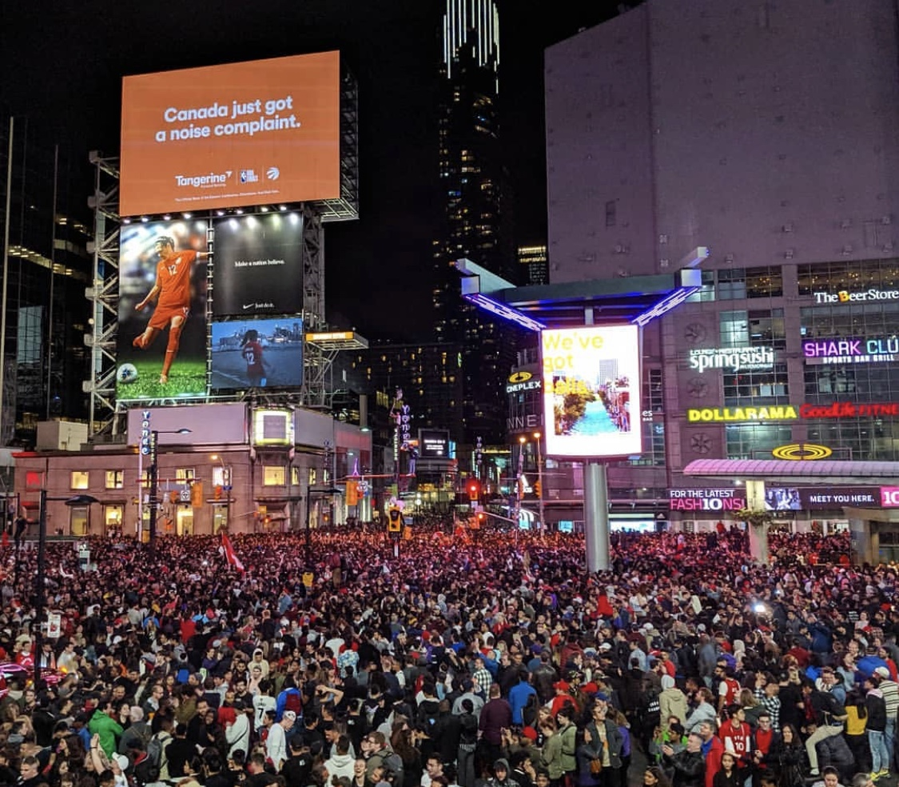

Slide 23

Dundas St E
Dundas Square
Queen St E
Street Party Geo-Fence
King St E
Bay St
Front St
Yonge St
Bremner
Jurassic Park Geo-Fence
Scotiabank Arena
Roundhouse
Notes:
This constant data flow helps businesses;
- discover and monitor audience trends and opportunities.
- make smart decisions,
- increase engagement
- and stay ahead of the competition.​

Slide 24
Dundas St E
Dundas Square
De-Identified
Profile Information
Queen St E
Combines with
location and behavioural data.
King St E
Mobile
Phone
Tracking
Bay St
Front St
Yonge St
Robust
Real Time
Collected Daily
Nationally
Bremner
Scotiabank Arena
Roundhouse
SOURCE: Bell MicroMarkets Data

Slide 25
Game 6 Pedestrian Traffic, INDEXED to:
Dundas St E
Dundas Square
Same time a week earlier
Same time a week earlier
627
Queen St E
533
King St E
371
390
Bay St
272
Front St
239
242
Yonge St
182
187
177
Bremner
Scotiabank Arena
Roundhouse
9-10
10-11
11-M
M-1
1-2
2-3
M-1
1-2
2-3
3-4
SOURCE: Bell MicroMarkets Data

Slide 26
Game 6 Pedestrian Traffic, INDEXED to:
Dundas St E
Dundas Square
Bell Subscribers in Total Canada
If the racial minorities
matched the country
100
Queen St E
W Asian
Korean
Chinese
King St E
S Asian
Bay St
Latin American
Front St
Black
Yonge St
Arab
SE Asian
Bremner
Scotiabank Arena
Filipino
Roundhouse
SOURCE: Bell MicroMarkets Data
Notes:
South Asian (East Indian, Pakistani, Sri Lankan, etc.)
East/South Asian (Cambodian, Indonesian, Laotian, Vietnamese)
West Asian (Afghan, Iranian, etc.)

Slide 27
Game 6 Pedestrian Traffic, INDEXED to:
Dundas St E
Dundas Square
Bell Subscribers in Total Canada
100
Queen St E
W Asian
282
Korean
256
Chinese
231
King St E
S Asian
219
Bay St
Latin American
190
Front St
Black
168
Yonge St
Arab
147
SE Asian
124
Bremner
Scotiabank Arena
Filipino
124
Roundhouse
SOURCE: Bell MicroMarkets Data

Slide 28
Game 6 Pedestrian Traffic, INDEXED to:
Dundas St E
Dundas Square
Bell Subscribers in Total Canada
Bell Subscribers in Toronto CMA
100
Queen St E
W Asian
95
282
Korean
105
256
Chinese
88
231
King St E
S Asian
58
219
Bay St
Latin American
108
190
Front St
Black
65
168
Yonge St
Arab
80
147
SE Asian
66
124
Bremner
Scotiabank Arena
Filipino
124
37
Roundhouse
SOURCE: Bell MicroMarkets Data

Slide 29
Diversity
We weren’t seeing Raptors diversity.
We were seeing Toronto diversity.

Slide 30
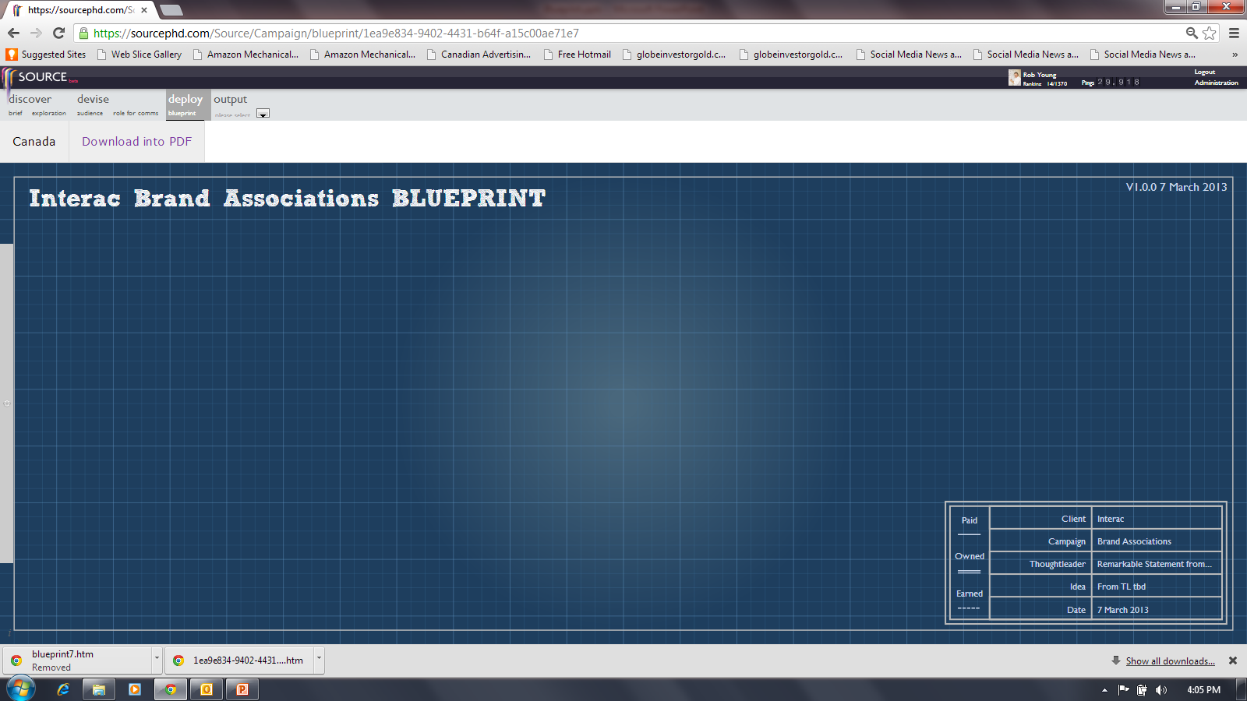
Diversity
A Canadian Blueprint.

Slide 31
TOTAL CANADIAN POPULATION (000)
34,460
Born in Canada
26,241
76%
Born Outside Canada
8,220
24%
Aboriginal
1,674
5%
3rd Generation +
18,466
54%
2nd Generation
6,101
18%
1st Generation
8,220
24%
Established Immigrant
<2010
6,329
18%
Recent Immigrant
1,212
4%
Non-Perm. Resident
507
2%
Non-Immigrant
26,413
77%

Slide 32
TOTAL CANADIAN POPULATION (000)
34,460
Born in Canada
26,241
76%
Born Outside Canada
8,220
24%
Aboriginal
1,674
5%
3rd Generation +
18,466
54%
2nd Generation
6,101
18%
1st Generation
8,220
24%
Established Immigrant
<2010
6,329
18%
Recent Immigrant
1,212
4%
Non-Perm. Resident
507
2%
Non-Immigrant
26,413
77%
Canadian Citizen
30,592
86%
Dual Citizens
1,442
4%
Non
2,426
7%
+
English Only
Language Known
16,794
49%
E/F only
Language Known
4,627
13%
French only
Language Known
3,670
11%
E/F + Non-Official
Language Known
8,807
26%
Non-Official Only
Language Known
562
2%
+

Slide 33
TOTAL CANADIAN POPULATION (000)
34,460
Born in Canada
26,241
76%
Born Outside Canada
8,220
24%
Aboriginal
1,674
5%
3rd Generation +
18,466
54%
2nd Generation
6,101
18%
1st Generation
8,220
24%
Established Immigrant
<2010
6,329
18%
Recent Immigrant
1,212
4%
Non-Perm. Resident
507
2%
Non-Immigrant
26,413
77%
Canadian Citizen
30,592
86%
Dual Citizens
1,442
4%
Non
2,426
7%
+
7%
English Only
Language Known
16,794
49%
E/F only
Language Known
4,627
13%
French only
Language Known
3,670
11%
E/F + Non-Official
Language Known
8,807
26%
Non-Official Only
Language Known
562
2%
+
RACIAL MINORITIES
7,765 22%

Slide 34
TOTAL CANADIAN POPULATION (000)
34,460
Born in Canada
26,241
76%
Born Outside Canada
8,220
24%
Aboriginal
1,674
5%
3rd Generation +
18,466
54%
2nd Generation
6,101
18%
1st Generation
8,220
24%
Established Immigrant
<2010
6,329
18%
Recent Immigrant
1,212
4%
Non-Perm. Resident
507
2%
Non-Immigrant
26,413
77%
7%
11%
4%
RACIAL MINORITIES
7,765 22%

Slide 35
TOTAL CANADIAN POPULATION (000)
34,460
Born in Canada
26,241
76%
Born Outside Canada
8,220
24%
Aboriginal
1,674
5%
3rd Generation +
18,466
54%
2nd Generation
6,101
18%
1st Generation
8,220
24%
Established Immigrant
<2010
6,329
18%
Recent Immigrant
1,212
4%
Non-Perm. Resident
507
2%
Non-Immigrant
26,413
77%
7%
11%
4%
RACIAL MINORITIES
7,765 22%

Slide 36
TOTAL CANADA
IMMIGRANTS
Non
Established
Recent
7%
11%
4%
RACIAL MINORITIES
7,765 22%

Slide 37
TOTAL CANADA
RACIAL MINORITIES
7,765 22%
IMMIGRANTS
Non
Composition
22%
Established
Recent
7%
11%
4%

Slide 38
RACIAL MINORITIES
TORONTO
VANCOUVER
MONTREAL
TOTAL CANADA
Composition
51%
Composition
49%
Composition
23%
Composition
22%

Slide 39
RACIAL MINORITIES
TORONTO
VANCOUVER
MONTREAL
TOTAL CANADA
Composition
51%
Composition
49%
Composition
23%
Composition
22%

Slide 40
TOTAL CANADA
TORONTO
VANCOUVER
MONTREAL
China 8.8%
Proportions of Populations by Country of Birth
India 5.6%
China 5.1%
India 5.3%
Philippines 4.1%
Philippines 3.4%
China 2.2%
India 2.1%
Philippines 1.8%
China 1.3%
Philippines .6%
India .5%

Slide 41
TOTAL CANADA
TORONTO
VANCOUVER
MONTREAL
Philippines 4.1%
Philippines 3.4%
Hong Kong 3.1%
Pakistan 2.1%
Philippines 1.8%
Hong Kong 1.8%
S. Korea 1.8%
Iran 1.5%
Hong Kong .6%
Iran 1.3%
Pakistan .6%
Philippines .6%
Viet Nam .5%
Viet Nam 1.0%
Viet Nam .6%
Iran .5%
S. Korea .4%

Slide 42
TOTAL CANADA
TORONTO
VANCOUVER
MONTREAL
Haiti 2.0%
Sri Lanka 1.8%
S. Korea 1.8%
Morocco 1.4%
Taiwan 1.6%
Algeria 1.4%
Jamaica 1.7%
Lebanon .9%
S. Korea .4%

Slide 43
TOTAL CANADA
TORONTO
VANCOUVER
MONTREAL
China 8.8%
India 5.6%
China 5.1%
India 5.3%
Philippines 4.1%
Philippines 3.4%
Hong Kong 3.1%
China 2.2%
India 2.1%
Pakistan 2.1%
Haiti 2.0%
Philippines 1.8%
Sri Lanka 1.8%
S. Korea 1.8%
Morocco 1.4%
Hong Kong 1.8%
Taiwan 1.6%
Algeria 1.4%
Jamaica 1.7%
Iran 1.5%
China 1.3%
Hong Kong .6%
Iran 1.3%
Lebanon .9%
Pakistan .6%
Philippines .6%
Viet Nam .5%
Viet Nam 1.0%
Viet Nam .6%
Iran .5%
India .5%
S. Korea .4%

Slide 44
TOTAL CANADA
TORONTO
VANCOUVER
MONTREAL
China 8.8%
India 5.6%
China 5.1%
India 5.3%
Racial
Minority
Philippines 4.1%
Philippines 3.4%
Hong Kong 3.1%
China 2.2%
India 2.1%
Pakistan 2.1%
Haiti 2.0%
Philippines 1.8%
Sri Lanka 1.8%
S. Korea 1.8%
Morocco 1.4%
Hong Kong 1.8%
Taiwan 1.6%
Algeria 1.4%
Jamaica 1.7%
Iran 1.5%
China 1.3%
Hong Kong .6%
Iran 1.3%
Lebanon .9%
Pakistan .6%
Philippines .6%
Viet Nam .5%
Viet Nam 1.0%
Viet Nam .6%
Iran .5%
India .5%
S. Korea .4%

Slide 45
RACIAL MINORITY
DEVICES INDEXED
to Adults 18+ French Canada
Racial
Minority
100
50

Slide 46
RACIAL MINORITY
DEVICES INDEXED
to Adults 18+ French Canada
LAPTOP
98
SMART SPEAKER 100
100 SMART PHONE
100
50
VR HEADSET 77
91 TABLET
107
131
GAME
CONSOLE
WEAR-
ABLES
^{SOURCE: vividata Spring 2019}

Slide 47
RACIAL MINORITY
DEVICES INDEXED
to Adults 18+ French Canada
LAPTOP
98
SMART SPEAKER 100
100 SMART PHONE
MID-RANGE
77 - 131
VR HEADSET 77
91 TABLET
107
131
GAME
CONSOLE
WEAR-
ABLES
^{SOURCE: vividata Spring 2019}

Slide 48
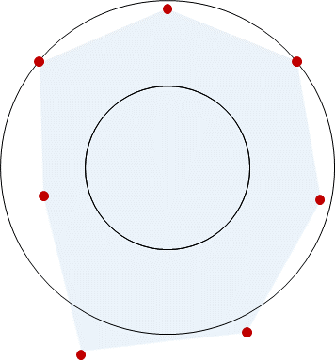
Diversity Propensity
Devices
Mid-Range
^{SOURCE: vividata Spring 2019}

Slide 49
Devices
French Canada

Slide 50





9
Devices
STV

Slide 51
9
Devices
18+
18+
18-34
100%
STV
50%
2014
2015
2016
2017
2018
2019

Slide 52
Internet Accessing Device Usage, amongst French Adults
Total
18+/18-34
18+
18+
18-34
100%
85%/90%
Desk/Laptop
89%/93%
STV
50%
Spring Surveys, MTM
2014
2015
2016
2017
2018
2019

Slide 53
Internet Accessing Device Usage, amongst French Adults
Total
18+/18-34
18+
18+
18-34
100%
79%/97%
Smart Phone
84%/95%
STV
50%
SP = Spring Surveys, MTM
2014
2015
2016
2017
2018
2019

Slide 54
Internet Accessing Device Usage, amongst French Adults
Total
18+/18-34
18+
18+
18-34
100%
STV
55%/50%
Tablet
50%
57%/48%
SP = Spring Surveys, MTM
2014
2015
2016
2017
2018
2019

Slide 55
Internet Accessing Device Usage, amongst French Adults
Total
18+/18-34
18+
18+
18-34
100%
STV
56%/56%
Smart TV *
50%
56%/56%
SP = Spring Surveys, MTM , * est’d by PHD Canada
2014
2015
2016
2017
2018
2019

Slide 56
Internet Accessing Device Usage, amongst French Adults
Total
18+/18-34
18+
18+
18-34
100%
STV
56%/56%
Smart TV *
50%
10%/18%
Computer
6%/ 8%
AppleTV
7%/11%
Chromecast
3%/ 1%
Roku
1/ 1%
FireStick
SP = Spring Surveys, MTM
2014
2015
2016
2017
2018
2019

Slide 57
Internet Accessing Device Usage, amongst French Adults
Total
18+/18-34
18+
18+
18-34
100%
STV
50%
24%/31%
Four Screens
34%/36%
SP = Spring Surveys, MTM
2014
2015
2016
2017
2018
2019

Slide 58
Internet Accessing Device Usage, amongst French Adults
Total
18+/18-34
18+
18+
18-34
100%
46%/73%
Game Console *
50%/71%
STV
50%
SP = Spring Surveys, MTM, * est’d by PHD Canada
2014
2015
2016
2017
2018
2019

Slide 59
Internet Accessing Device Usage, amongst French Adults
Total
18+/18-34
18+
18+
18-34
100%
STV
50%
17%/18%
Wearables
25%/30%
7%/ 7%
FitBit
3%/ 3%
AppleWatch
SP = Spring Surveys, MTM
2014
2015
2016
2017
2018
2019

Slide 60
Internet Accessing Device Usage, amongst French Adults
Total
18+/18-34
18+
18+
18-34
100%
STV
50%
9%/ 9%
Car Connect
9%/ 9%
SP = Spring Surveys, MTM, * est’d by PHD Canada
2014
2015
2016
2017
2018
2019

Slide 61
Internet Accessing Device Usage, amongst French Adults
Total
18+/18-34
18+
18+
18-34
100%
STV
50%
6%/ 6%
VR Headset *
7%/ 7%
SP = Spring Surveys, MTM, * est’d by PHD Canada
2014
2015
2016
2017
2018
2019

Slide 62
Internet Accessing Device Usage, amongst French Adults
Total
18+/18-34
18+
18+
18-34
100%
STV
50%
13%/19%
Smart Speakers
19%/24%
SP = Spring Surveys, MTM
2014
2015
2016
2017
2018
2019

Slide 63
Internet Accessing Device Usage, amongst French Adults
18+
18+
18-34
100%
85%/90%
Desk/Laptop
79%/97%
Smart Phone
46%/73%
Game Console *
STV
56%/56%
Smart TV *
55%/50%
Tablet
50%
17%/18%
Wearables
13%/19%
Smart Speakers
9%/ 9%
Car Connect
6%/ 6%
VR Headset *
SP = Spring Surveys, MTM
2014
2015
2016
2017
2018
2019

Slide 64

Device Penetration and Potential
LOW
Growth Potential
HIGH
DEEP
STV
Penetration
SHALLOW

Slide 65
DEVICES
RACIAL MINORITY
ADULTS 18+
One propensity of note.
“Smart” is still growing.

Slide 66
Media

Slide 67
RACIAL MINORITY
MEDIA INDEXED
to Adults 18+ French Canada
TV
99
74 RADIO
OOH 77
100
50
INTERNET 105
115 NEWSPR
91
MAGAZINE
^{SOURCE: vividata Spring 2019}

Slide 68
RACIAL MINORITY
MEDIA INDEXED
to Adults 18+ French Canada
TV
99
74 RADIO
OOH 77
Very similar to Fr Adults 18+
INTERNET 105
115 NEWSPR
91
MAGAZINE
^{SOURCE: vividata Spring 2019}

Slide 69

Diversity Propensity
Devices
Mid-Range
Media
Similar
^{SOURCE: vividata Spring 2019}

Slide 70
Media
French Canada

Slide 71
100%
90%
Numeris
TV/Radio
80%
VIVIDATA
NEWSPAPER
MAGAZINE
INTERNET
WEEKLY REACH %
Navigator
OUT of HOME
60%
50%
40%
500
1,000
WEEKLY MINUTES
2,000
3,000

Slide 72
100%
90%
80%
WEEKLY REACH %
French Adults Weekly Reach/Minutes
60%
2001
TV
A
97%
L+7
50%
40%
500
1,000
WEEKLY MINUTES
2,000
3,000

Slide 73
100%
90%
80%
WEEKLY REACH %
French Adults Weekly Reach/Minutes
60%
2001
TV
A
97%
1,659
50%
40%
500
1,000
WEEKLY MINUTES
2,000
3,000

Slide 74
100%
A
90%
80%
A
A
WEEKLY REACH %
French Adults Weekly Reach/Minutes
60%
2001
TV
A
97% 1,659
RADIO
NEWSPAPER
MAGAZINE
INTERNET
A
93% 1,308
78% 167
77% 105
45% 245
A
50%
A
A
A
40%
500
1,000
WEEKLY MINUTES
2,000
3,000

Slide 75
100%
A
90%
80%
A
A
WEEKLY REACH %
French Adults Weekly Reach/Minutes
60%
2001
2017
TV
A
97% 1,659
99% 1,974
RADIO
NEWSPAPER
MAGAZINE
INTERNET
A
93% 1,308
78% 167
77% 105
45% 245
89% 966
62% 68
51% 22
98% 1,289
A
50%
A
A
A
40%
500
1,000
WEEKLY MINUTES
2,000
3,000

Slide 76
100%
A
90%
80%
A
A
WEEKLY REACH %
French Adults Weekly Reach/Minutes
60%
2001
2017
TV
A
97% 1,659
99% 1,974
RADIO
NEWSPAPER
MAGAZINE
INTERNET
A
93% 1,308
78% 167
77% 105
45% 245
89% 966
62% 68
51% 22
98% 1,289
A
50%
A
A
A
40%
500
1,000
WEEKLY MINUTES
2,000
3,000

Slide 77
100%
A
A
90%
A
80%
WEEKLY REACH %
French Adults Weekly Reach/Minutes
60%
A
2017
2018
2019
TV
99% 1,974
A
97% 1,926
97% 1,842
RADIO
NEWSPAPER
MAGAZINE
INTERNET
89% 966
62% 68
51% 22
98% 1,289
88% 949
88% 948
A
61% 69
58% 59
A
48% 19
45% 18
50%
A
99% 1,424
97% 1,372
A
A
40%
500
1,000
WEEKLY MINUTES
2,000
3,000

Slide 78
100%
A
A
90%
A
80%
WEEKLY REACH %
French Adults 2019¹
Weekly Reach/Minutes
TV
French Adults Weekly Reach/Minutes
60%
A
2017
2018
2019
TV
18+
97% 1,842
99% 1,974
A
97% 1,926
97% 1,842
RADIO
NEWSPAPER
MAGAZINE
INTERNET
89% 966
62% 68
51% 22
98% 1,289
88% 949
88% 948
A
61% 69
58% 59
A
48% 19
45% 18
50%
A
99% 1,424
97% 1,372
A
A
¹ Sp/Fall 2018 Numeris
40%
500
1,000
WEEKLY MINUTES
2,000
3,000

Slide 79
100%
Older age skew.
90%
80%
WEEKLY REACH %
French Adults 2019¹
Weekly Reach/Minutes
TV
60%
18+
97% 1,842
18-24
25-34
35-54
55+
94% 1,062
93% 984
96% 1,332
99% 2,736
50%
¹ Sp/Fall 2018 Numeris
40%
500
1,000
WEEKLY MINUTES
2,000
3,000

Slide 80
100%
90%
80%
WEEKLY REACH %
18-24 year old reach/time continues to decline.
French Adults 2019 ¹ Weekly Reach/Minutes
RADIO
60%
18+
88% 948
18-24
25-34
35-54
55+
66% 448
84% 687
93% 980
89% 1,132
50%
¹ Fall 2018 Numeris
40%
500
1,000
WEEKLY MINUTES
2,000
3,000

Slide 81
100%
90%
80%
WEEKLY REACH %
Older demo, heaviest reader.
French Adults 2019 ¹ Weekly Reach/Minutes
NEWSPAPER
60%
18+
58% 59
18-24
25-34
35-54
55+
43% 35
53% 36
56% 47
64% 85
50%
¹ Spring 2019 Vividata
40%
500
1,000
WEEKLY MINUTES
2,000
3,000

Slide 82
100%
90%
80%
WEEKLY REACH %
French Adults 2019 ¹ Weekly Reach/Minutes
MAGAZINE
60%
18+
45% 18
18-24
25-34
35-54
55+
30% 11
36% 12
45% 16
53% 23
Older demo - heaviest Magazine reader.
50%
¹ Spring 2019 Vividata
40%
500
1,000
WEEKLY MINUTES
2,000
3,000

Slide 83
100%
Youth skew
55+ are light users
90%
80%
WEEKLY REACH %
French Adults 2019 ¹ Weekly Reach/Minutes
INTERNET
60%
18+
97% 1,372
18-24
25-34
35-54
55+
97% 1,576
97% 1,504
94% 1,418
90% 1,226
50%
¹ Spring 2019 vividata
40%
500
1,000
WEEKLY MINUTES
2,000
3,000

Slide 84
100%
Very similar.
T
Lighter TV viewers in Total Canada than in French Canada.
T
90%
T
Not much difference.
80%
WEEKLY REACH %
60%
Total Adults 18+ 2019 Weekly Reach + Minutes
INTERNET ¹
MAGAZINE ¹
NEWSPAPER ¹
RADIO ¹
TV ¹
98% 1,376
T
47% 15
48% 54
T
87% 878
T
93% 1,512
50%
T
T
T
Much lower reach.
¹ Spring 2019 vividata
¹ Spring 2019 Vividata
¹ Spring 2019 Vividata
¹ Fall 2018 Numeris
¹ Sp/Fall 2018 Numeris
T
More reach.
40%
500
1,000
WEEKLY MINUTES
2,000
3,000

Slide 85
100%
90%
A
Moving from old “car counting”
to new “mobile location” based measurement.
80%
WEEKLY REACH %
Total/French Adults 2019 ¹ Weekly Reach/Minutes
OUT of HOME
60%
TV
Radio
Newspaper
Magazine
Internet
18+
A
85% 80
18-24
25-34
35-54
55+
80% 70
82% 75
86% 85
90% 90
50%
^{1 Navigator}
40%
500
1,000
WEEKLY MINUTES
2,000
3,000

Slide 86
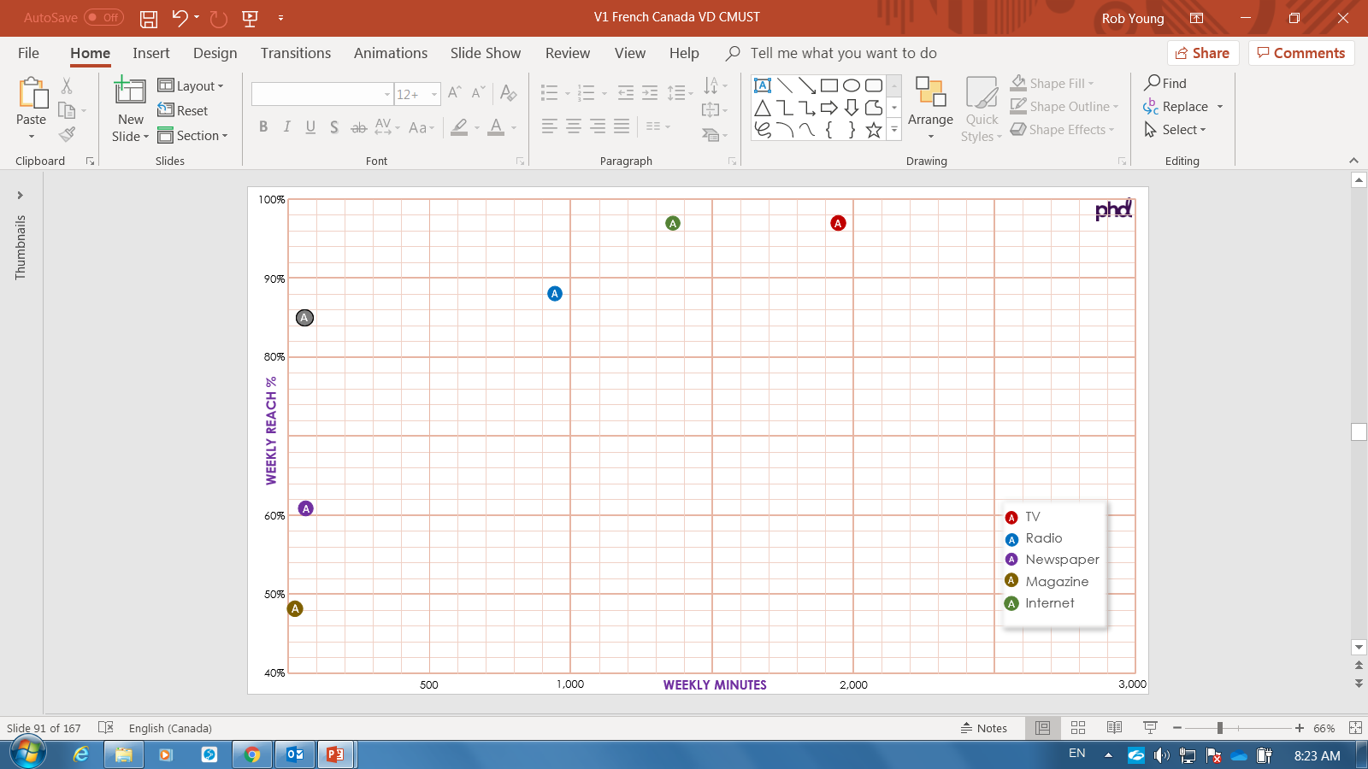












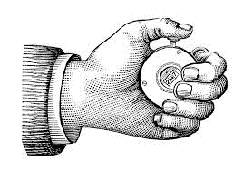

2021
Reach
Frequency
GRPs
MAPPING
RFI
LATE
2020
SUMMER
2020
100%
NEW
365 DAYS
MARKET
Notes:
NEW COMMB measurement will provide multi-directional vehicular traffic counts for all Canadian roads.

Slide 87
2021
Reach
Frequency
GRPs
MAPPING
RFI
LATE
2020
SUMMER
2020
100%
NEW
365 DAYS
MARKET
Notes:
Occupancy rates will be based on market not provincial data.
In vs Out market factors will be based upon full year surveys rather than the shorter surveys used currently.
And this by Summer 2020.

Slide 88
2021
Reach
Frequency
GRPs
MAPPING
RFI
LATE
2020
SUMMER
2020
100%
NEW
365 DAYS
MARKET
Notes:
Digital Board audience will be tracked by time of day.
That gives us more relevant audience count.

Slide 89
2021
Reach
Frequency
GRPs
MAPPING
RFI
LATE
2020
SUMMER
2020
100%
NEW
365 DAYS
MARKET
Notes:
Traffic counts gets integrated with mobile location data.
This allows for identification of the home neighborhood of people going by a location.
And that in turn, allows for the creation of an audience profile for each OOH face.
Late 2020 for these new insights.

Slide 90
2021
Reach
Frequency
GRPs
MAPPING
RFI
LATE
2020
SUMMER
2020
100%
NEW
365 DAYS
MARKET
Notes:
All this new audience measurement will be face location specific.
It will be housed in COMMB’s new Media Suite planning system.
Accessible to COMMB members in 2021.

Slide 91
MEDIA
RACIAL MINORITY
ADULTS 18+
Similar to total adults.
Internet growth slowing.
Saturation of simul-media time.

Slide 92
Audio

Slide 93
RACIAL MINORITY
INDEXED to
Adults 18+ French Canada
100
50
109 ONLINE AUDIO
^{SOURCE: vividata Spring 2019}

Slide 94
RACIAL MINORITY
INDEXED to
Adults 18+ French Canada
109 ONLINE AUDIO
SLIGHT PROPENSITY 109
^{SOURCE: vividata Spring 2019}

Slide 95

Diversity Propensity
Devices
Mid-Range
Media
Mid-Range
Online Audio
A Propensity
^{SOURCE: vividata Spring 2019}

Slide 96
Audio
French Canada

Slide 97
Online Audio is made up of…
Music streaming free and paid subscription.
This includes music consumed on YouTube.
Podcasts.
AM and FM Online Radio.

Slide 98




A pattern is emerging… growth.
Trends have been consistent.
Monthly online tuning data now available by market.
Total audio reach and time captured.
The Canadian
Podcast Listener
2019
In-depth examination of Podcast reach, time, downloads.

Slide 99

Contextualizing Podcasts.
How they’re doing it in Total Canada.
YOUTUBE 43%
APPLE ITUNES 34%
12% RADIO STN SITE/APP
13% OTHER APPS
SPOTIFY 24%
17% GOOGLE PLAY
PRODUCER’S SITES 20%
Source: The Canadian Podcast Listener 2019
Total Canada 18+ (n=3,040) Platforms used by listeners in past year.

Slide 100
Online Audio reach and time grew this year.
French Adult 18+, Weekly
French Adult 18-34, Weekly
Reach
Minutes/Capita
Reach
Minutes/Capita
50%
Total Online Audio
68%
319
91%
440
Streamed Music
60%
201
87%
286
Podcasts
12%
40
28%
112
Radio Online
21%
78
20%
41
¹ The Canadian Podcast Listener 2019, Audience Insights Inc., Ulster Media (May/June/July 2019)
² Numeris PPM Radio Streaming Report, August 2019, 12+, 6 market average share of total radio tuning = 7% of 878 mpc = 60 mpc. Reach est’d at 20% based upon the time spent level.
³ MTM MpC reduced by 25%.

Slide 101
100%
90%
80%
WEEKLY REACH %
Developing quickly.
French Adults 18+
2019 ¹ Weekly Reach/Minutes
ONLINE AUDIO
60%
N
TV
Radio
Newspaper
Magazine
Internet
OOH
Total Online Audio
68% 319
N
50%
M
M
MTM Spring 2019, comScore, PHD Estimates
40%
500
1,000
WEEKLY MINUTES
2,000
3,000

Slide 102
AUDIO
RACIAL MINORITY
ADULTS 18+
Similar to total adults.
New tech.
Evolving platforms.
Growth in time.

Slide 103
Video

Slide 104
RACIAL MINORITY
INDEXED to
Adults 18+ French Canada
100
50
106 ONLINE VIDEO
^{SOURCE: vividata Spring 2019}

Slide 105
RACIAL MINORITY
INDEXED to
Adults 18+ French Canada
106 ONLINE VIDEO
SLIGHT PROPENSITY
106
^{SOURCE: vividata Spring 2019}

Slide 106

Diversity Propensity
Devices
Mid-Range
Media
Mid-Range
Online Audio
A Propensity
Online Video
Slight Propensity
^{SOURCE: vividata Spring 2019}

Slide 107
Video
French Canada

Slide 108
Online Video is made up of…
PUREPLAY
On-Demand TV and Movies
NETFLIX
Crave
Amazon Prime Video
COBRANDED
TV Broadcasters
Websites and apps
TV everywhere apps
TV content on YouTube

Slide 109
Quantification is a struggle.
Time counts have been consistent.
Total video reach and time captured.
Video Audience Measurement (VAM).
Ontario/Quebec Panels 2020.
Notes:
Numeris is currently recruiting and building the VAM digital panel, starting with Ontario and Quebec.
They hope to have beta data in the Spring 2019 to present to our BOD in June 2019.

Slide 110
V
Video
Audience
Measurement
A
M

Slide 111

BV
Video Tag
T
Served
Broadcaster Video
S
Devices in/out of Home
BV
S
T
Notes:
The VAM process begins with Broadcasters tagging their digital video content.
When that video is served to a consumer, the consumption of that video content is tracked.

Slide 112





Focal Meter Household Panel
PANEL
CENSUS
1,080
900
O
Q
BV
S
T
T
T
T
Notes:
That served content, along with it’s tag, is captured by comScore and this record of video consumption is called “census”.
Think of it as census traffic running down a train track to comScore.
There are two rail sidings along the way; an Ontario and a Quebec siding.
And these two sidings are special, focal meter equipped, household panels; about 1,000 homes per panel.

Slide 113

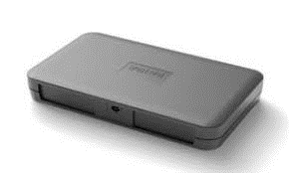
PANEL
CENSUS
O
Q
Notes:
And so we have panel data, that uses a special video detecting focal meter, and a census picture via comScore.

Slide 114
PANEL
CENSUS
Content
Length
Device
Time
Content
Length
Device
Time
FULL DEMO
NO DEMO
IN HOME ONLY
T
TOTAL
OUT of HOME
Notes:
The tagged census data captures the video content, length of the content, the device used and the time spent count.
But no demographic data.
The Panel captures Content, Length, Device and Time, plus full demographic data thanks to a household questionaiire.
While the census data is total data…
… the panel provides an in-home tuning picture only…
… and the subtraction provides the out-of-home video usage picture.

Slide 115



PANEL
PANEL
CENSUS
Content
Length
Device
Time
Content
Length
Device
Time
UNTAGGED
Device
Time
FULL DEMO
FULL DEMO
NO DEMO
IN HOME ONLY
T
TOTAL
NO CONTENT
NO Out of HOME
OUT of HOME
Notes:
The Kantar Focal Meter panels is capable of capturing PurePlay video like YouTube and Netflix and Amazon Prime Video.
But sorry… no tags, no content.
Device and time spent only.
And there will only be an in-home reading.

Slide 116
PANEL
PANEL
PANEL
CENSUS
Pure Play
Time Spent
Broadcaster
Broadcaster
Content
Length
Device
Time
Content
Length
Device
Time
T
T
UNTAGGED
Device
Time
FULL DEMO
FULL DEMO
NO DEMO
IN HOME ONLY
T
TOTAL
NO CONTENT
NO Out of HOME
OUT of HOME
Notes:
In effect, there are three “buckets of data”.
The tagged census data. The tagged panel data and the untagged PurePlay panel data.

Slide 117
PANEL
PANEL
PANEL
CENSUS
Pure Play
Time Spent
Broadcaster
Broadcaster
T
T
PPM
PANEL
Notes:
Enter the Numeris Portable People Meter audience data – the Broadcaster currency.

Slide 118
FUSION
PANEL
PANEL
PANEL
CENSUS
Cross Platform
Viewing Data
Pure Play
Time Spent
Broadcaster
Broadcaster
T
T
PPM
PANEL
Notes:
A fusion of PPM data with the tagged video audience data will create a Cross Platform broadcaster legacy and online Video viewing picture.

Slide 119
CALIBRATION
PANEL
CENSUS
Cross Platform
Viewing Data
Pure Play
Time Spent
Broadcaster
T
Notes:
Which in turn can be calibrated using the “real, census-based” picture of viewing.
Supplemented with an in-home PurePlay time spend count.

Slide 120
VAM
Program audience by full demo.
Unduplicated cross-platform reach (cobrand).
Pure-Play time spent by full demo (in-home).
How should cross-platform viewing be reported?
Numeris hosted Metrics Committee coming soon.
Want more (like timing)?
English https://www.numeriscanada.com/vam_en/ French https://www.numeriscanada.com/vam_fr/

Slide 121
Video is stabilizing.
French Adult 18+, Weekly
French Adult 18-34, Weekly
Reach
Minutes/Capita
Reach
Minutes/Capita
Total Online Video
84%
628
95%
967
Total PurePlay
70%
479
89%
743
CoBranded
48%
149
54%
224
NETFLIX (in PP)
34%
147
64%
308

Slide 122
100%
90%
80%
WEEKLY REACH %
French Adults 18+
2019 ¹ Weekly Reach/Minutes
ONLINE VIDEO
60%
N
TV
Radio
Newspaper
Magazine
Internet
OOH
Total Online Video
PurePlay Video
CoBrand Video
84% 628
70% 479
48% 149
N
50%
M
M
MTM Spring 2019, comScore, July ‘19, PHD Estimates
40%
500
1,000
WEEKLY MINUTES
2,000
3,000

Slide 123
VIDEO
RACIAL MINORITY
ADULTS 18+
Slightly heavier than total adults.
Revenge of the cobrand.
OTT scramble.

Slide 124
Unearthed

Slide 125
RACIAL MINORITY
INDEXED to
Adults 18+ French Canada
142
VIDEO
129
HEALTH
SHORT FORM VIDEO
89
80
WEATHER
89
FOOD
124
PODCAST/RADIO
90
YOUTUBE
150
100
50
108
ENTERTAINMENT
91
MAPS
94
NEWS
98
104
MUSIC STREAMING
READ PAPER MAG
SEARCH
100
96
SHOPPING
^{SOURCE: vividata Spring 2019}

Slide 126
RACIAL MINORITY
VIDEO
INDEXED to
Adults 18+ French Canada
142
HEALTH
WEATHER
129
80
FOOD
SHORT FORM VIDEO
89
89
PODCAST/RADIO
124
YOUTUBE
90
AUDIO/VIDEO SKEW
124 - 142
108
91
MAPS
ENTERTAINMENT
104
94
NEWS
100
96
MUSIC STREAMING
98
READ PAPER MAG
SEARCH
SHOPPING
^{SOURCE: vividata Spring 2019}

Slide 127

Diversity Propensity
Devices
Mid-Range
Media
Mid-Range
Online Audio
A Propensity
Online Video
Slight Propensity
Unearthed
Wide Propensity
^{SOURCE: vividata Spring 2019}

Slide 128
Unearthed
French Canada

Slide 129
French Canada
Adults 18+
Minutes per Capita
Vividata Found
1,372
Notes:
That’s 21 hours per week or 3 hours per day.

Slide 130
French Canada
Adults 18+
Minutes per Capita
Unearthed
1,993
+45%
Vividata Found
1,372
Notes:
30 hours per week or 4 hours per day.

Slide 131
French Canada
Adults 18+
Minutes per Capita
Unearthed
1,993
+45%
Online
Audio
319
Print
90
Video
628
Online
Gaming
20
Text/Interaction
607
Social
138
Other
191

Slide 132
French Canada
Adults 18+
Minutes per Capita
Online
Audio
319
Online
Gaming
20
Print
90
Social
138
Other
191
Text/Interaction
607
Video
628
PurePlay
+ Cobrand
Game Console
Wearables
CCars
SSpeakers
FB et al
Podcast
Radio
Streaming
One Way +
Banking
Buying
Trading

Slide 133
French Canada
Adults 18+
Minutes per Capita
Unearthed
1,993
Online
Audio
319
Online
Gaming
20
Print
90
Social
138
Other
191
Text/Interaction
607
Video
628

Slide 134
French Canada
Adults 18+
Minutes per Capita
Unearthed
1,993
Mobile
1,093

Slide 135
French Canada
Adults 18+
Minutes per Capita
Mobile
1,093
DeskTop
539

Slide 136
French Canada
Adults 18+
Minutes per Capita
DeskTop
539
Mobile
1,093
STV
170 Video

Slide 137
French Canada
Adults 18+
Minutes per Capita
Smart
Speakers
30
Wear-
ables
68
Game
Console
68
Mobile
1,093
CCars
25
STV
170 Video
DeskTop
539

Slide 138
French Canada
Adults 18+
Minutes per Capita
DEVICES
CONTENT

Slide 139
100%
90%
80%
WEEKLY REACH %
French Adult 18+
2019 ¹ Weekly Reach/Minutes
UNEARTHED INTERNET
60%
UNEARTHED
98% 1.993
50%
MTM Spring 2019, eMarketer May ‘19, vivdata Spring 2019, PHD Estimates
40%
500
1,000
WEEKLY MINUTES
2,000
3,000

Slide 140
100%
90%
80%
WEEKLY REACH %
French Adult 18+
2019 ¹ Weekly Reach/Minutes
UNEARTHED INTERNET
60%
N
TV
Radio
Newspaper
Magazine
Internet
OOH
UNEARTHED
98% 1.993
N
50%
M
M
MTM Spring 2019, eMarketer May ‘19, vivdata Spring 2019, PHD Estimates
40%
500
1,000
WEEKLY MINUTES
2,000
3,000

Slide 141
INTERNET UNEARTHED
RACIAL MINORITY
ADULTS 18+
4 categories of note.
33% of Internet unmeasured.
Steady.
New entry points.

Slide 142
Money

Slide 143
RACIAL MINORITY
PROPORTION of
Total Media Expenditure 2018
$13,425
(million)
$279
(million)
Those who don’t know the official languages
= 2%
2%
SOURCE: CRTC 2018 broadcast financial summaries + PHD estimates.

Slide 144
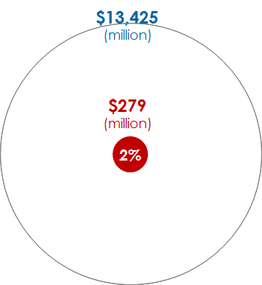
Diversity Propensity
Devices
Mid-Range
Media
Mid-Range
Online Audio
A Propensity
Online Video
Slight Propensity
$13,425
(million)
$279
(million)
Unearthed
Wide Propensity
2%
Money
Lacking knowledge of
official languages = 2%
^{SOURCE: vividata Spring 2019}

Slide 145
Money
Total Canada

Slide 146
Ad Revenue $13,300
(Millions, no OOH or ComNewspr)
Minutes 4,526
(Per Capita Weekly Adults 18+ Internet UE)
100%
100%
Total excludes OOH/Com Newspaper. Internet ad revenue from published ThinkTV Ad Rev document for 2018. MpC from 2019 CMUST, Total Canada using Internet Unearthed.

Slide 147
Internet Revenue $7,592
(Millions, 2018)
Internet Minutes 2,067
(Per Capita Weekly Ad 18+ Internet UE 2019)
46%
57%
Internet ad revenue from published ThinkTV Ad Rev document for 2018. MPC from 2018 CMUST using Internet Unearthed.

Slide 148
Internet revenue has become very over-developed.
Internet Revenue $7,592
(Millions, 2018)
Internet Minutes 2,067
(Per Capita Weekly Ad 18+ Internet UE 2019)
46%
57%
Internet ad revenue from published ThinkTV Ad Rev document for 2018. MPC from 2018 CMUST using Internet Unearthed.

Slide 149
Very quickly.
Internet revenue has become very over-developed.
Internet revenue has become very over-developed.
Internet Revenue $7,717
(Millions, 2018)
Internet Minutes 2,067
(Per Capita Weekly Ad 18+ Internet UE 2019)
2015
2019
57%
46%
46%
58%
43%
34%
Share of Time Internet 2015 – 2019 ²
Share of Revenue Internet 2014 – 2018 ¹
Internet ad revenue from published ThinkTV Ad Rev document for 2018. MPC from 2018 CMUST using Internet Unearthed.

Slide 150
Internet Revenue $7,717
(Millions, 2018)
Internet Minutes 2,067
(Per Capita Weekly Ad 18+ Internet UE 2019)
100%
100%
Internet ad revenue from published ThinkTV Ad Rev document for 2018. MPC from 2019 CMUST using Internet Unearthed.

Slide 151
Mobile Revenue $4,792
(Millions)
Mobile Minutes 944
(Per Capita Weekly Ad 18+ Internet UE)
46%
63%
Internet ad revenue from published ThinkTV Ad Rev document for 2018. MPC from 2019 CMUST using Internet Unearthed.

Slide 152
Mobile revenues surpass consumer time.
Mobile Revenue $4,792
(Millions)
Mobile Minutes 949
(Per Capita Weekly Ad 18+ Internet UE)
46%
63%
Internet ad revenue from published ThinkTV Ad Rev document for 2018. MPC from 2019 CMUST using Internet Unearthed.

Slide 153
Video Revenue $1,822
(Millions)
Video Minutes 735
Per Capita Weekly Ad 18+ Internet UE
24%
36%
Internet ad revenue from published ThinkTV Ad Rev document for 2018. MPC from 2019 CMUST using Internet Unearthed.

Slide 154
Video revenue will never catch up to consumer time.
Video Revenue
$1,822 (Millions)
Video Minutes 735
Per Capita Weekly
Ad 18+ Internet UE
24%
36%
Internet ad revenue from published ThinkTV Ad Rev document for 2018. MPC from 2019 CMUST using Internet Unearthed.

Slide 155
Social Revenue $1,320
(Millions)
Social Minutes 138
Per Capita Weekly Ad 18+ Internet UE
17%
7%
Social ad revenue PHD Canada est’d. MPC from 2019 CMUST using Internet Unearthed.

Slide 156
Social revenue is overdeveloped.
Social Revenue
$1,320 (Millions)
Social Minutes
138 MpC wkly
17%
7%
Social ad revenue PHD Canada est’d. MPC from 2019 CMUST using Internet Unearthed.

Slide 157
MONEY
RACIAL MINORITY
ADULTS 18+
2%
Internet overdeveloping quickly.

Slide 158
FIVE IMPLICATIONS

Slide 159
1
New audio marketing frontier is unfolding.
Streamed Music
Podcasting
Radio Online
Audio books
Ear Pods
Smart Speakers

Slide 160
2
A re-evaluation of TV is in play.
The video field is shifting.
Low Value
High Value
Procurement Driven
Globally Driven
Low CPRP
Low Reach
Market Sensitive
Canadian Driven
Higher CPRP
High Reach
CURRENT
Average Level of Branded TV Commercial Recognition ¹
EARLY 2010’s
250 GRP
FROM 36% to 26%
500 GRP
FROM 42% to 31%
1,000 GRP
FROM 47% to 36%
¹ IPSOS Global Tracking Data Base.

Slide 161
CPRPs
TV Revenue 2019

Slide 162
3
Three measurement battles are being waged.
1
Census (clickstream)
vs
Panel (sample)
2
Content
vs
Commercial
3
Industry
vs
Proprietary

Slide 163
4
Internet Revenue is overdeveloping quickly.
Over-Activation? Over-Short-termism? Under-Branding?
How Brands Grow Part 2
Romaniuk/Sharp
Lemon
Wood
Effectiveness in Context
Binet/Field
The Crisis in Creative Effectiveness
Field, 2019
Factors Driving Ad Effectiveness
Ritson
¹ Revenue is one year delayed from time. Share of TV, Radio, Newspaper, Magazine, Internet revenues.
² Internet Share of Time from CMUST studies.

Slide 164
5
The Diversity Conversation.
Ethnic/Mainstream
Cultural Cross-Pollination
Match offer to Settlement Stage
In-language
Appreciation > Comprehension
Migration Nation
Environics Research group
Brown and Cheng

Slide 165
That’s it.
I hope you found
a media “ring of truth” here.

Slide 166
Sources
Popularity of stories
Raptors and comparative TV audiences
Raptor Game 6 Twitter volumes
Toronto geo-fenced pedestrian traffic data
Diversity data
Diversity Actions
Device penetration
TV weekly time/reach, 2019
Radio weekly time/reach , 2019
Internet weekly time/reach , 2019
Magazine weekly time/reach , 2019
Newspaper weekly time/reach , 2019
Out of Home
OOH measurement methodology
Cobranded audio weekly time/reach
Podcast weekly time/reach and tuning dynamics
Streamed music weekly time/reach
Cobranded video
Pureplay video desktop and mobile
Pureplay video smart TV
Netflix
Video Audience Measurement methodology
Internet unearthed
2018 Ad Revenues published
2018 Ad Revenues unpublished
Time spent shares by medium
Ethnic Ad Revenue
Google Trends
Numeris TV PPM Anglo Canada, Toronto EM and Montreal EM.
Twitter Canada, Alyson Gausby,
MicroMarkets, Bell Media, Karen Pettingill.
Stats Canada Census 2016
Migration Nation, Environics Research group, Brown and Cheng
MTM Spring 2019 unless indicated otherwise as PHD estimated.
Numeris, Spring’18/Fall’18 PPM averaged.
Numeris, Fall’18, Diary
Vividata Spring 2019
Vividata Spring 2019, generic question.
Vividata Spring 2019, 72 daily rollup.
Navigator, using PHD estimates of time spent per impression.
COMMB, Rosanne Caron
Numeris PPM Radio Streaming Report shares applied to Radio totals
The Canadian Podcast Listener 2019, Audience Insights Inc., Ulster Media.
MTM Spring 2019, reduced by PHD estimate of respondent over claim.
MTM Spring 2019, reduced PHD estimate of respondent over claim.
Vividata Spring 2019, plus PHD estimates.
MTM Spring ‘19 Pureplay.
MTM Spring 2019
Numeris VAM, Rob Fullerton
Vividata Spring 2019, MTM Spring 2019, PHD estimates
2018 Annual Ad Expenditures Report, compiled by ThinkTV, Kathy Gardner
PHD estimates
CMUST 2019
2018 CRTC Radio and Discretionary Service actuals + PHD estimates for balance.
Notes:
Ethan Frome is a book published in 1911 by the Pulitzer Prize-winning American author Edith Wharton. It is set in the fictitious town of Starkfield, Massachusetts. The novel was adapted into a film, Ethan Frome, in 1993. The novel is framed by the literary device of an extended flashback. The prologue, which is neither named as such nor numbered, opens with an unnamed male narrator spending a winter in Starkfield while in the area on business. He spots a limping, quiet man around the village, who is somehow compelling in his demeanor and carriage. This is Ethan Frome.

Slide 168
Contextualizing Podcasts.
Who’s doing what in Total Canada?
ADULTS 18+ Total Canada
NEW 12%
MONTHLY LISTENERS 26%
TENURED 3%
WEEKLY LISTENERS 17%
POWER 7%
Source: The Canadian Podcast Listener 2019
Total Canada 18+ (n=3,040) Monthly Podcast Listeners (n = 1,538)
Power Listeners spend 5+ hours per week with Podcasts.
New Listeners first started listening to Podcasts a year ago of more recently.
Tenured Listeners have been listening to Podcasts for 5 or more years now.

Slide 169
PLAYOFFS
30
Adults 18+, Anglo Canada
Adults 18+, Toronto
25
1.7
X’s
20
15
RATING
10
5
2.5
X’s
Week Sunday 2019
7
14
21
28
5
12
19
26
2
9
APRIL
MAY
JUNE

