Slide 1
2019
19
C
Canadian
Media
Usage
STudy
M
U
ST
Total Canada
Rob Young
PHD Canada, November 2019

Slide 2








Stories

Slide 3
Raptors
Diversity
Stories

Slide 4
Raptors
Diversity
Devices
Media
Audio
Video
Unearthed
Money
Implications
Diversity
Raptors
Diversity
Diversity
Diversity
Diversity
Diversity

Slide 5






100
50
June 4th
July 2nd
Aug 6th
Sept 3rd
Oct 1st
Nov 5th
Dec 3rd
Jan 7th
Feb 4th
Mar 4th
Apr 1st
May 6th
June 3rd
July 1st
2018
2019

Slide 6

100
50
June 4th
July 2nd
Aug 6th
Sept 3rd
Oct 1st
Nov 5th
Dec 3rd
Jan 7th
Feb 4th
Mar 4th
Apr 1st
May 6th
June 3rd
July 1st
2018
2019

Slide 7
100
50
June 4th
July 2nd
Aug 6th
Sept 3rd
Oct 1st
Nov 5th
Dec 3rd
Jan 7th
Feb 4th
Mar 4th
Apr 1st
May 6th
June 3rd
July 1st
2018
2019

Slide 8
Adults 18+, Anglo Canada
Average Minute Audience (000)
100
4,000
3,000
50
2,000
1,000
June 4th
July 2nd
Aug 6th
Sept 3rd
Oct 1st
Nov 5th
Dec 3rd
Jan 7th
Feb 4th
Mar 4th
Apr 1st
May 6th
June 3rd
July 1st
2018
2019

Slide 9
PLAYOFFS
Adults 18+, Anglo Canada
Average Minute Audience (000)
4,000
3,000
2,000
1,000
June 4th
July 2nd
Aug 6th
Sept 3rd
Oct 1st
Nov 5th
Dec 3rd
Jan 7th
Feb 4th
Mar 4th
Apr 1st
May 6th
June 3rd
July 1st
2018
2019

Slide 10
PLAYOFFS
Adults 18+, Anglo Canada
Average Minute Audience (000)
4,000
GS WARRIORS
Games 1-6
3,000
AMA
(000)
MILWALKEE
Games 1-6
2,000
ORLANDO
Games 1-5
PHILADELPHIA
Games 1-7
1,000
Week Sunday 2019
7
14
21
28
5
12
19
26
2
9
APRIL
MAY
JUNE

Slide 11
PLAYOFFS
Adults 18+, Anglo Canada
20
4,000
15
3,000
AMA
(000)
RATING
10
2,000
5
1,000
Week Sunday 2019
7
14
21
28
5
12
19
26
2
9
APRIL
MAY
JUNE

Slide 12
PLAYOFFS
30
Adults 18+, Anglo Canada
Adults 18+, Toronto
25
20
15
RATING
10
5
Week Sunday 2019
7
14
21
28
5
12
19
26
2
9
APRIL
MAY
JUNE

Slide 13
PLAYOFFS
GAME 6
30
Adults 18+, Anglo Canada
Adults 18+, Toronto
25
20
15
RATING
10
5
Week Sunday 2019
7
14
21
28
5
12
19
26
2
9
THURSDAY
JUNE 13th
APRIL
MAY
JUNE

Slide 14
34 35-49
GAME 6
30
Adults 18+, Toronto
29 M
29 25-34
27 18-24
28 18+
27 F
27 50-64
25
22 65+
20
15
RATING
10
5
THURSDAY
JUNE 13th

Slide 15
GAME 6
30
Adults 18+, Toronto
Superbowl
25
24.2
Academy Awards
19.4
20
Big Bang Theory
17.4
15
Golden Globes
11.6
RATING
Game of Thrones (8)
10.6
10
5
THURSDAY
JUNE 13th

Slide 16
GAME 6
Adults 18+, Anglo Canada
30
Minute by Minute Play
Adults 18+, Toronto
25
20
15
RATING
10
1st Hour
2nd Hour
3rd Hour
5
THURSDAY
JUNE 13th

Slide 17
GAME 6
Adults 18+, Anglo Canada
30
Minute by Minute Play
25
20
15
RATING
Anglo Canada
10
1st Hour
2nd Hour
3rd Hour
5
THURSDAY
JUNE 13th

Slide 18
GAME 6
30
25
20
Toronto
15
RATING
Anglo Canada
10
5
Montreal Fr
1st Hour
2nd Hour
3rd Hour
THURSDAY
JUNE 13th

Slide 19
GAME 6
14
All Persons Total Canada
Twitter Volume by Minute (000)
7
1st Hour
2nd Hour
3rd Hour

Slide 20
GAME 6
14
All Persons Total Canada
Twitter Volume by Minute (000)
7
1st Hour
2nd Hour
3rd Hour

Slide 21
Twitter Volume by Minute (000)
14
7
1st Hour
MIDNIGHT
EST
2nd Hour
3rd Hour

Slide 22
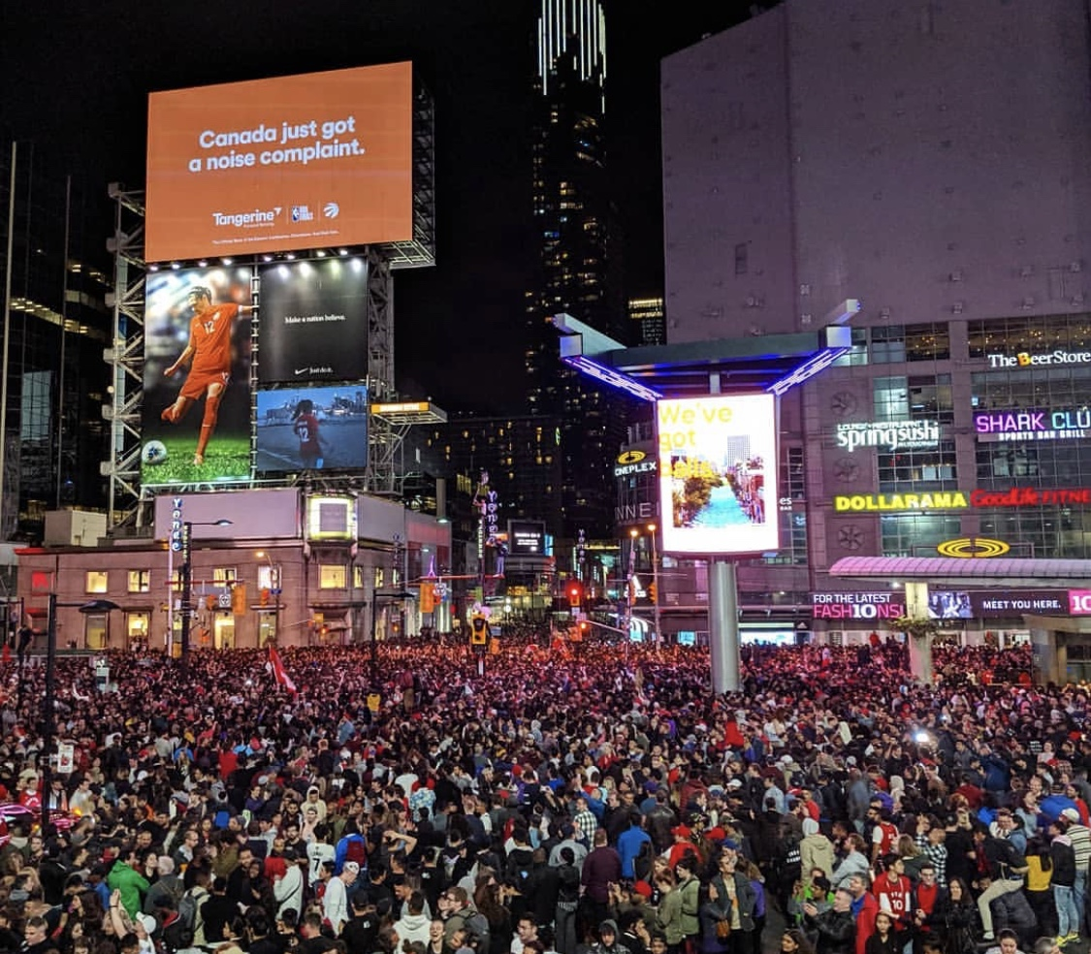

Slide 23

Dundas St E
Dundas Square
Queen St E
Street Party Geo-Fence
King St E
Bay St
Front St
Yonge St
Bremner
Jurassic Park Geo-Fence
Scotiabank Arena
Roundhouse
Notes:
This constant data flow helps businesses;
- discover and monitor audience trends and opportunities.
- make smart decisions,
- increase engagement
- and stay ahead of the competition.​

Slide 24
Dundas St E
Dundas Square
De-Identified
Profile Information
Queen St E
Combines with
location and behavioural data.
King St E
Mobile
Phone
Tracking
Bay St
Front St
Yonge St
Robust
Real Time
Collected Daily
Nationally
Bremner
Scotiabank Arena
Roundhouse

Slide 25
Game 6 Pedestrian Traffic, INDEXED to:
Dundas St E
Dundas Square
Same time a week earlier
Same time a week earlier
627
Queen St E
533
King St E
371
390
Bay St
272
Front St
239
242
Yonge St
182
187
177
Bremner
Scotiabank Arena
Roundhouse
9-10
10-11
11-M
M-1
1-2
2-3
M-1
1-2
2-3
3-4
SOURCE: Bell MicroMarkets Data

Slide 26
Game 6 Pedestrian Traffic, INDEXED to:
Dundas St E
Dundas Square
Bell Subscribers in Total Canada
If racial minorities
matched the country…
100
Queen St E
W Asian
Korean
Chinese
King St E
S Asian
Bay St
Latin American
Front St
Black
Yonge St
Arab
SE Asian
Bremner
Scotiabank Arena
Filipino
Roundhouse
SOURCE: Bell MicroMarkets Data
Notes:
South Asian (East Indian, Pakistani, Sri Lankan, etc.)
East/South Asian (Cambodian, Indonesian, Laotian, Vietnamese)
West Asian (Afghan, Iranian, etc.)

Slide 27
Game 6 Pedestrian Traffic, INDEXED to:
Dundas St E
Dundas Square
Bell Subscribers in Total Canada
100
Queen St E
W Asian
282
Korean
256
Chinese
231
King St E
S Asian
219
Bay St
Latin American
190
Front St
Black
168
Yonge St
Arab
147
SE Asian
124
Bremner
Scotiabank Arena
Filipino
124
Roundhouse
SOURCE: Bell MicroMarkets Data

Slide 28
Game 6 Pedestrian Traffic, INDEXED to:
Dundas St E
Dundas Square
Bell Subscribers in Total Canada
Bell Subscribers in Toronto CMA
100
Queen St E
W Asian
95
282
Korean
105
256
Chinese
88
231
King St E
S Asian
58
219
Bay St
Latin American
108
190
Front St
Black
65
168
Yonge St
Arab
80
147
SE Asian
66
124
Bremner
Scotiabank Arena
Filipino
124
37
Roundhouse
SOURCE: Bell MicroMarkets Data

Slide 29
Diversity
We weren’t seeing Raptors diversity.
We were seeing Toronto diversity.

Slide 30
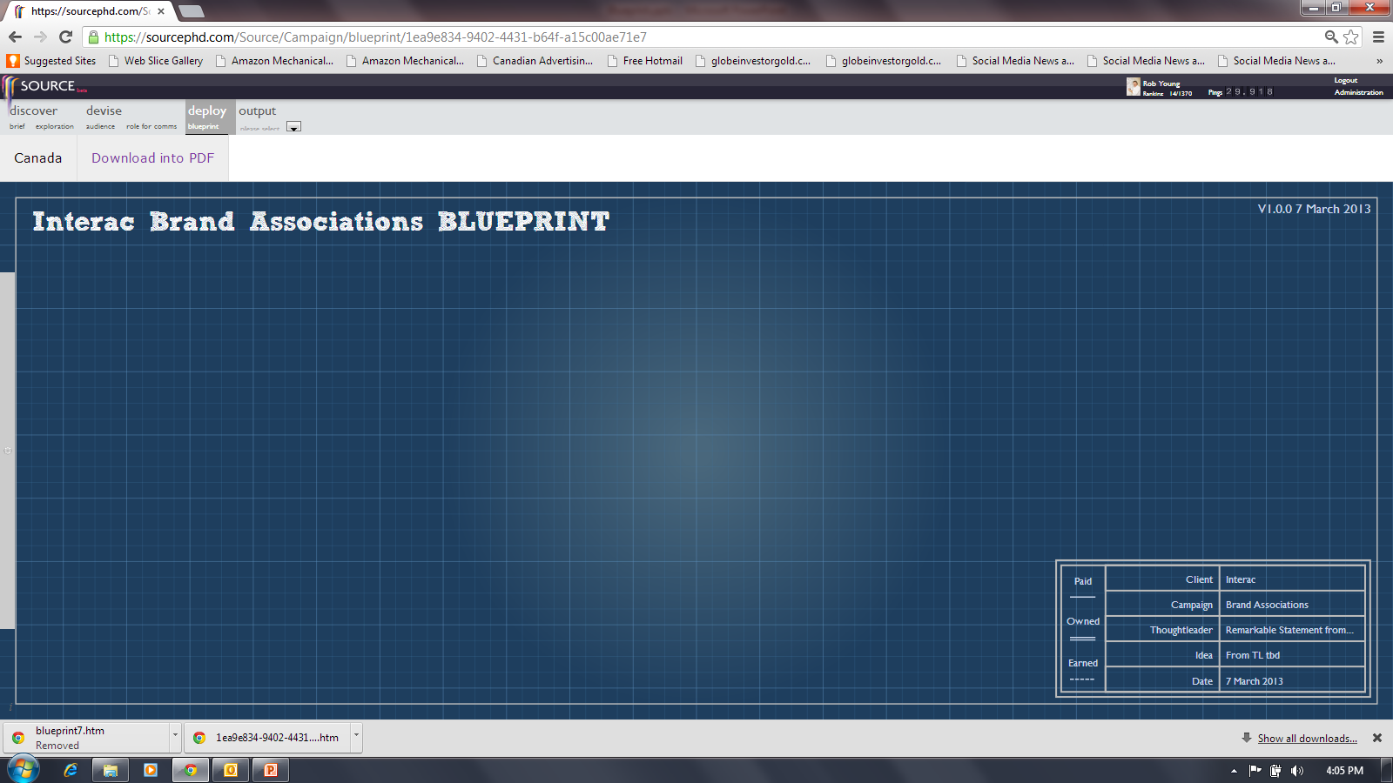
Diversity
A Canadian Blueprint.

Slide 31
TOTAL CANADIAN POPULATION (000)
34,460
Born in Canada
26,241
76%
Born Outside Canada
8,220
24%
Aboriginal
1,674
5%
3rd Generation +
18,466
54%
2nd Generation
6,101
18%
1st Generation
8,220
24%
Established Immigrant
<2010
6,329
18%
Recent Immigrant
1,212
4%
Non-Perm. Resident
507
2%
Non-Immigrant
26,413
77%

Slide 32
TOTAL CANADIAN POPULATION (000)
34,460
Born in Canada
26,241
76%
Born Outside Canada
8,220
24%
Aboriginal
1,674
5%
3rd Generation +
18,466
54%
2nd Generation
6,101
18%
1st Generation
8,220
24%
Established Immigrant
<2010
6,329
18%
Recent Immigrant
1,212
4%
Non-Perm. Resident
507
2%
Non-Immigrant
26,413
77%
Canadian Citizen
30,592
86%
Dual Citizens
1,442
4%
Non
2,426
7%
+
English Only
Language Known
16,794
49%
E/F only
Language Known
4,627
13%
French only
Language Known
3,670
11%
E/F + Non-Official
Language Known
8,807
26%
Non-Official Only
Language Known
562
2%
+

Slide 33
TOTAL CANADIAN POPULATION (000)
34,460
Born in Canada
26,241
76%
Born Outside Canada
8,220
24%
Aboriginal
1,674
5%
3rd Generation +
18,466
54%
2nd Generation
6,101
18%
1st Generation
8,220
24%
Established Immigrant
<2010
6,329
18%
Recent Immigrant
1,212
4%
Non-Perm. Resident
507
2%
Non-Immigrant
26,413
77%
Canadian Citizen
30,592
86%
Dual Citizens
1,442
4%
Non
2,426
7%
+
7%
English Only
Language Known
16,794
49%
E/F only
Language Known
4,627
13%
French only
Language Known
3,670
11%
E/F + Non-Official
Language Known
8,807
26%
Non-Official Only
Language Known
562
2%
+
RACIAL MINORITIES
7,765 22%

Slide 34
TOTAL CANADIAN POPULATION (000)
34,460
Born in Canada
26,241
76%
Born Outside Canada
8,220
24%
Aboriginal
1,674
5%
3rd Generation +
18,466
54%
2nd Generation
6,101
18%
1st Generation
8,220
24%
Established Immigrant
<2010
6,329
18%
Recent Immigrant
1,212
4%
Non-Perm. Resident
507
2%
Non-Immigrant
26,413
77%
7%
11%
4%
RACIAL MINORITIES
7,765 22%

Slide 35
TOTAL CANADIAN POPULATION (000)
34,460
Born in Canada
26,241
76%
Born Outside Canada
8,220
24%
Aboriginal
1,674
5%
3rd Generation +
18,466
54%
2nd Generation
6,101
18%
1st Generation
8,220
24%
Established Immigrant
<2010
6,329
18%
Recent Immigrant
1,212
4%
Non-Perm. Resident
507
2%
Non-Immigrant
26,413
77%
7%
11%
4%
RACIAL MINORITIES
7,765 22%

Slide 36
TOTAL CANADA
IMMIGRANTS
Non
Established
Recent
7%
11%
4%
RACIAL MINORITIES
7,765 22%

Slide 37
TOTAL CANADA
RACIAL MINORITIES
7,765 22%
IMMIGRANTS
Non
Composition
22%
Established
Recent
7%
11%
4%

Slide 38
RACIAL MINORITIES
TORONTO
VANCOUVER
MONTREAL
TOTAL CANADA
Composition
51%
Composition
49%
Composition
23%
Composition
22%

Slide 39
RACIAL MINORITIES
TORONTO
VANCOUVER
MONTREAL
TOTAL CANADA
Composition
51%
Composition
49%
Composition
23%
Composition
22%

Slide 40
TOTAL CANADA
TORONTO
VANCOUVER
MONTREAL
China 8.8%
Proportions of Populations by Country of Birth
India 5.6%
China 5.1%
India 5.3%
Philippines 4.1%
Philippines 3.4%
China 2.2%
India 2.1%
Philippines 1.8%
China 1.3%
Philippines .6%
India .5%

Slide 41
TOTAL CANADA
TORONTO
VANCOUVER
MONTREAL
Philippines 4.1%
Philippines 3.4%
Hong Kong 3.1%
Pakistan 2.1%
Philippines 1.8%
Hong Kong 1.8%
S. Korea 1.8%
Iran 1.5%
Hong Kong .6%
Iran 1.3%
Pakistan .6%
Philippines .6%
Viet Nam .5%
Viet Nam 1.0%
Viet Nam .6%
Iran .5%
S. Korea .4%

Slide 42
TOTAL CANADA
TORONTO
VANCOUVER
MONTREAL
Haiti 2.0%
Sri Lanka 1.8%
S. Korea 1.8%
Morocco 1.4%
Taiwan 1.6%
Algeria 1.4%
Jamaica 1.7%
Lebanon .9%
S. Korea .4%

Slide 43
TOTAL CANADA
TORONTO
VANCOUVER
MONTREAL
China 8.8%
India 5.6%
China 5.1%
India 5.3%
Philippines 4.1%
Philippines 3.4%
Hong Kong 3.1%
China 2.2%
India 2.1%
Pakistan 2.1%
Haiti 2.0%
Philippines 1.8%
Sri Lanka 1.8%
S. Korea 1.8%
Morocco 1.4%
Hong Kong 1.8%
Taiwan 1.6%
Algeria 1.4%
Jamaica 1.7%
Iran 1.5%
China 1.3%
Hong Kong .6%
Iran 1.3%
Lebanon .9%
Pakistan .6%
Philippines .6%
Viet Nam .5%
Viet Nam 1.0%
Viet Nam .6%
Iran .5%
India .5%
S. Korea .4%

Slide 44
TOTAL CANADA
TORONTO
VANCOUVER
MONTREAL
China 8.8%
India 5.6%
China 5.1%
India 5.3%
Racial
Minority
Philippines 4.1%
Philippines 3.4%
Hong Kong 3.1%
China 2.2%
India 2.1%
Pakistan 2.1%
Haiti 2.0%
Philippines 1.8%
Sri Lanka 1.8%
S. Korea 1.8%
Morocco 1.4%
Hong Kong 1.8%
Taiwan 1.6%
Algeria 1.4%
Jamaica 1.7%
Iran 1.5%
China 1.3%
Hong Kong .6%
Iran 1.3%
Lebanon .9%
Pakistan .6%
Philippines .6%
Viet Nam .5%
Viet Nam 1.0%
Viet Nam .6%
Iran .5%
India .5%
S. Korea .4%

Slide 45
RACIAL MINORITY
DEVICES INDEXED
to Adults 18+ Total Canada
Racial
Minority
100
50

Slide 46
RACIAL MINORITY
DEVICES INDEXED
to Adults 18+ Total Canada
LAPTOP
99
SMART SPEAKER 97
105 SMART PHONE
100
50
98 TABLET
VR HEADSET 127
110
123
GAME
CONSOLE
WEAR-
ABLES
^{SOURCE: vividata Spring 2019}

Slide 47
RACIAL MINORITY
DEVICES INDEXED
to Adults 18+ Total Canada
LAPTOP
99
SMART SPEAKER 97
105 SMART PHONE
NARROW RANGE
97 - 127
98 TABLET
VR HEADSET 127
110
123
GAME
CONSOLE
WEAR-
ABLES
^{SOURCE: vividata Spring 2019}

Slide 48
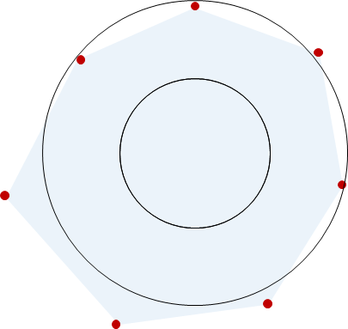
Diversity Propensity
Devices
Narrow Range
^{SOURCE: vividata Spring 2019}

Slide 49
Devices
Total Canada

Slide 50





9
Devices
STV

Slide 51
9
Devices
18+
18+
18-34
100%
STV
50%
2014
2015
2016
2017
2018
2019

Slide 52
Internet Accessing Device Usage, amongst Adults
18+
18+
18-34
100%
89%/93%
Desk/Laptop
STV
50%
Spring Surveys, MTM
2014
2015
2016
2017
2018
2019

Slide 53
Internet Accessing Device Usage, amongst Adults
18+
18+
18-34
100%
84%/95%
Smart Phone
STV
50%
SP = Spring Surveys, MTM
2014
2015
2016
2017
2018
2019

Slide 54
Internet Accessing Device Usage, amongst Adults
18+
18+
18-34
100%
STV
57%/48%
Tablet
50%
SP = Spring Surveys, MTM
2014
2015
2016
2017
2018
2019

Slide 55
Internet Accessing Device Usage, amongst Adults
18+
18+
18-34
100%
STV
56%/56%
Smart TV*
50%
SP = Spring Surveys, MTM, * est’d by PHD Canada
2014
2015
2016
2017
2018
2019

Slide 56
Internet Accessing Device Usage, amongst Adults
18+
18+
18-34
100%
STV
56%/56%
Smart TV*
50%
14%/23%
Computer
8%/12%
AppleTV
8%/10%
Chromecast
3%/4%
Roku
2%/3%
FireStick
SP = Spring Surveys, MTM, * est’d by PHD Canada
2014
2015
2016
2017
2018
2019

Slide 57
Internet Accessing Device Usage, amongst Adults
18+
18+
18-34
100%
STV
50%
34%/36%
Four Screens
SP = Spring Surveys, MTM
2014
2015
2016
2017
2018
2019

Slide 58
Internet Accessing Device Usage, amongst Adults
18+
18+
18-34
100%
STV
50%
50%/71%
Game Console*
SP = Spring Surveys, MTM
2014
2015
2016
2017
2018
2019

Slide 59
Internet Accessing Device Usage, amongst Adults
18+
18+
18-34
100%
STV
50%
25%/30%
Wearables
15%/16%
FitBit
5%/ 7%
AppleWatch
SP = Spring Surveys, MTM
2014
2015
2016
2017
2018
2019

Slide 60
Internet Accessing Device Usage, amongst Adults
18+
18+
18-34
100%
STV
50%
9%/9%
Car Connectivity*
SP = Spring Surveys, MTM, * est’d by PHD Canada
2014
2015
2016
2017
2018
2019

Slide 61
Internet Accessing Device Usage, amongst Adults
18+
18+
18-34
100%
STV
50%
7%/7%
VR Headset *
SP = Spring Surveys, MTM, * est’d by PHD Canada
2014
2015
2016
2017
2018
2019

Slide 62
Internet Accessing Device Usage, amongst Adults
18+
18+
18-34
100%
STV
50%
19%/24%
Smart Speakers
12%/16%
Google Home
4%/6%
Amazon Echo
SP = Spring Surveys, MTM
2014
2015
2016
2017
2018
2019

Slide 63
Internet Accessing Device Usage, amongst Adults
18+
18+
18-34
100%
89%/93%
Desk/Laptop
84%/95%
Smart Phone
STV
57%/48%
Tablet
56%/56%
Smart TV*
50%
50%/71%
Game Console*
25%/30%
Wearables
19%/24%
Smart Speakers
9%/9%
Car Connectivity*
SP = Spring Surveys, MTM
2014
2015
2016
2017
2018
2019

Slide 64

Device Penetration and Potential
LOW
Growth Potential
HIGH
DEEP
STV
Penetration
SHALLOW

Slide 65
DEVICES
RACIAL MINORITY
ADULTS 18+
Similar to total adults.
“Smart” is still growing.

Slide 66
Media

Slide 67
RACIAL MINORITY
MEDIA INDEXED
to Adults 18+ Total Canada
TV
94
OOH 87
81 RADIO
100
50
INTERNET 111
111 NEWSPR
96
MAGAZINE
^{SOURCE: vividata Spring 2019}

Slide 68
RACIAL MINORITY
MEDIA INDEXED
to Adults 18+ Total Canada
TV
94
OOH 87
81 RADIO
NARROW RANGE
81 - 111
INTERNET 111
111 NEWSPR
96
MAGAZINE
^{SOURCE: vividata Spring 2019}

Slide 69

Diversity Propensity
Devices
Narrow Range
Media
Narrow Range
^{SOURCE: vividata Spring 2019}

Slide 70
Media
Total Canada

Slide 71
100%
90%
NUMERIS
TV/Radio
80%
VIVIDATA
NEWSPAPER
MAGAZINE
INTERNET
WEEKLY REACH %
Navigator
OUT of HOME
60%
50%
40%
500
1,000
WEEKLY MINUTES
2,000
3,000

Slide 72
100%
90%
80%
WEEKLY REACH %
Adults Weekly Reach/Minutes
60%
2001
TV
A
96%
L+7
50%
40%
500
1,000
WEEKLY MINUTES
2,000
3,000

Slide 73
100%
90%
80%
WEEKLY REACH %
Adults Weekly Reach/Minutes
60%
2001
TV
A
96% 1,531
50%
40%
500
1,000
WEEKLY MINUTES
2,000
3,000

Slide 74
100%
A
90%
A
80%
A
WEEKLY REACH %
Adults Weekly Reach/Minutes
60%
2001
TV
A
96% 1,531
RADIO
NEWSPAPER
MAGAZINE
INTERNET
94% 1,282
82% 184
73% 77
52% 311
A
A
A
A
50%
A
40%
500
1,000
WEEKLY MINUTES
2,000
3,000

Slide 75
100%
A
90%
A
80%
A
WEEKLY REACH %
Adults Weekly Reach/Minutes
60%
2001
2017
TV
A
96% 1,531
97% 1,632
RADIO
NEWSPAPER
MAGAZINE
INTERNET
94% 1,282
82% 184
73% 77
52% 311
88% 913
54% 64
54% 20
98% 1,281
A
A
A
A
50%
A
40%
500
1,000
WEEKLY MINUTES
2,000
3,000

Slide 76
100%
A
90%
A
80%
A
WEEKLY REACH %
Adults Weekly Reach/Minutes
60%
2001
2017
TV
A
96% 1,531
97% 1,632
RADIO
NEWSPAPER
MAGAZINE
INTERNET
94% 1,282
82% 184
73% 77
52% 311
88% 913
54% 64
54% 20
98% 1,281
A
A
A
A
50%
A
40%
500
1,000
WEEKLY MINUTES
2,000
3,000

Slide 77
100%
A
A
90%
A
80%
WEEKLY REACH %
Adults Weekly Reach/Minutes
60%
2017
2018
2019
TV
97% 1,632
A
95% 1,554
93% 1,512
RADIO
NEWSPAPER
MAGAZINE
INTERNET
88% 913
54% 64
54% 20
98% 1,281
87% 903
87% 878
A
52% 59
48% 54
A
A
A
51% 18
47% 15
50%
A
98% 1,395
98% 1,376
A
40%
500
1,000
WEEKLY MINUTES
2,000
3,000

Slide 78
100%
A
A
90%
A
80%
WEEKLY REACH %
Adults 2019 Weekly Reach/Minutes
TV
Adults Weekly Reach/Minutes
60%
2017
2018
2019
TV
97% 1,632
93% 1,512
93% 1,512
A
95% 1,554
RADIO
NEWSPAPER
MAGAZINE
INTERNET
88% 913
54% 64
54% 20
98% 1,281
87% 903
87% 878
A
52% 59
48% 54
A
A
A
51% 18
47% 15
50%
A
98% 1,395
98% 1,376
A
Sp/Fall 2018
40%
500
1,000
WEEKLY MINUTES
2,000
3,000

Slide 79
100%
90%
Older, 55+ stable viewers.
80%
WEEKLY REACH %
Adults 2019 Weekly Reach/Minutes
TV
60%
18+
18-24
25-34
35-54
55+
93% 1,512
88% 852
86% 702
93% 1,188
98% 2,286
50%
Sp/Fall 2018
40%
500
1,000
WEEKLY MINUTES
2,000
3,000

Slide 80
100%
90%
80%
WEEKLY REACH %
18-24 reach continues to decline.
Adults 2019 Weekly Reach/Minutes
RADIO
60%
18+
87% 878
18-24
25-34
35-54
55+
69% 457
80% 615
92% 887
89% 1,081
50%
Fall 2018 Numeris
40%
500
1,000
WEEKLY MINUTES
2,000
3,000

Slide 81
100%
90%
80%
WEEKLY REACH %
Adults 2019 Weekly Reach/Minutes
NEWSPAPER
60%
Older demo, heaviest reader.
18+
48% 54
18-24
25-34
35-54
55+
43% 31
43% 29
45% 36
55% 88
50%
Spring 2019 Vividata
40%
500
1,000
WEEKLY MINUTES
2,000
3,000

Slide 82
100%
90%
80%
WEEKLY REACH %
Adults 2019 Weekly Reach/Minutes
MAGAZINE
60%
Older demo is the heaviest Magazine reader.
18+
47% 15
18-24
25-34
35-54
55+
33% 10
37% 11
46% 14
58% 19
50%
Spring 2019 Vividata
40%
500
1,000
WEEKLY MINUTES
2,000
3,000

Slide 83
100%
Youth skew.
55+ year old adults
light Internet users.
90%
80%
WEEKLY REACH %
Adults 2019 Weekly Reach/Minutes
INTERNET
60%
18+
98% 1,376
18-24
25-34
35-54
55+
98% 1,656
98% 1,529
96% 1,401
90% 1,202
50%
Spring ‘19 vivdata, modified w MTM Sp ‘19 reach
40%
500
1,000
WEEKLY MINUTES
2,000
3,000

Slide 84
100%
Very similar
Heavier tuners
90%
A bit deeper and heavier
80%
WEEKLY REACH %
60%
Deeper reach
French Adults 18+ 2019 Weekly Reach + Minutes
INTERNET
MAGAZINE
NEWSPAPER
RADIO
TV
50%
97% 1,372
45% 18
58% 59
88% 948
97% 1,842
Spring 2019 vividata
Spring 2019 Vividata
Spring 2019 Vividata
Fall 2018 Numeris
Sp/Fall 2018 Numeris
Less reach
40%
500
1,000
WEEKLY MINUTES
2,000
3,000

Slide 85
100%
90%
A
Moving from old “car counting”
to new “mobile location” based measurement.
80%
WEEKLY REACH %
Adults Weekly Reach/Minutes
OUT of HOME
60%
TV
Radio
Newspaper
Magazine
Internet
18+
A
85% 80
18-24
25-34
35-54
55+
80% 70
82% 75
86% 85
90% 90
50%
^{Navigator}
40%
500
1,000
WEEKLY MINUTES
2,000
3,000

Slide 86
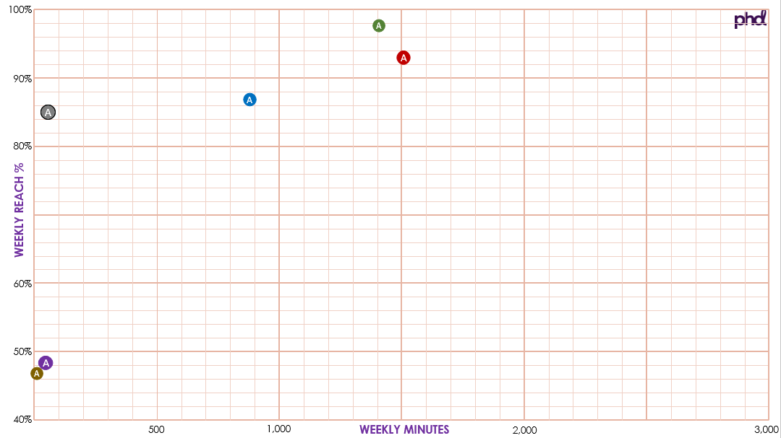
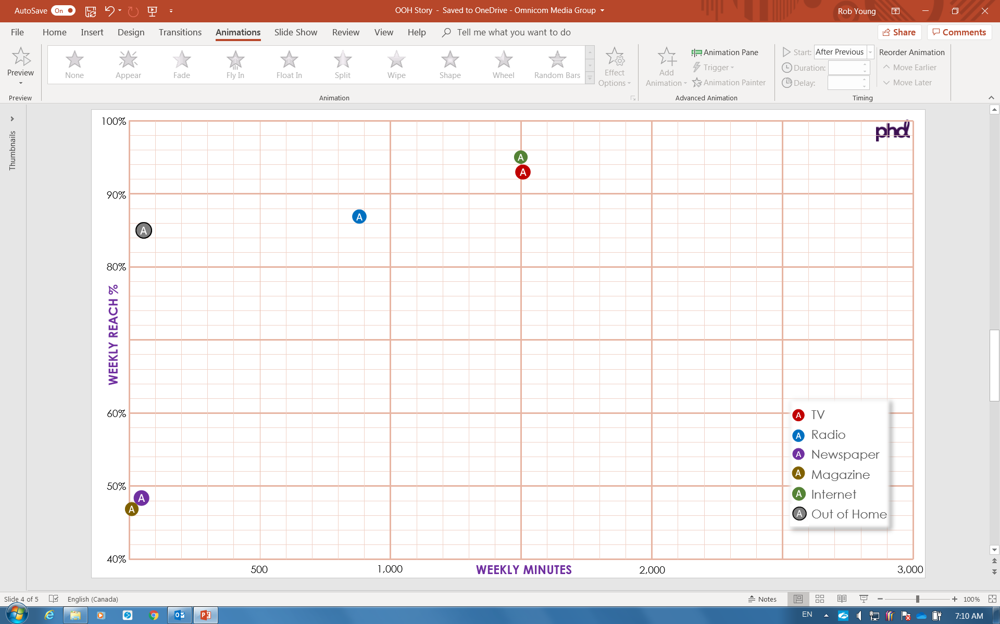












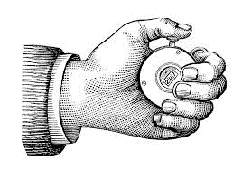

2021
Reach
Frequency
GRPs
MAPPING
RFI
LATE
2020
SUMMER
2020
100%
NEW
365 DAYS
MARKET
Notes:
NEW COMMB measurement will provide multi-directional vehicular traffic counts for all Canadian roads.

Slide 87
2021
Reach
Frequency
GRPs
MAPPING
RFI
LATE
2020
SUMMER
2020
100%
NEW
365 DAYS
MARKET
Notes:
Occupancy rates will be based on market not provincial data.
In vs Out market factors will be based upon full year surveys rather than the shorter surveys used currently.
And this by Summer 2020.

Slide 88
2021
Reach
Frequency
GRPs
MAPPING
RFI
LATE
2020
SUMMER
2020
100%
NEW
365 DAYS
MARKET
Notes:
Digital Board audience will be tracked by time of day.
That gives us more relevant audience count.

Slide 89
2021
Reach
Frequency
GRPs
MAPPING
RFI
LATE
2020
SUMMER
2020
100%
NEW
365 DAYS
MARKET
Notes:
Traffic counts gets integrated with mobile location data.
This allows for identification of the home neighborhood of people going by a location.
And that in turn, allows for the creation of an audience profile for each OOH face.
Late 2020 for these new insights.

Slide 90
2021
Reach
Frequency
GRPs
MAPPING
RFI
LATE
2020
SUMMER
2020
100%
NEW
365 DAYS
MARKET
Notes:
All this new audience measurement will be face location specific.
It will be housed in COMMB’s new Media Suite planning system.
Accessible to COMMB members in 2021.

Slide 91
MEDIA
RACIAL MINORITY
ADULTS 18+
Similar to total adults.
Internet time growth slowing.
Saturation of simul-media time.

Slide 92
Audio

Slide 93
RACIAL MINORITY
INDEXED to
Adults 18+ Total Canada
100
50
119 ONLINE AUDIO
^{SOURCE: vividata Spring 2019}

Slide 94
RACIAL MINORITY
INDEXED to
Adults 18+ Total Canada
119 ONLINE AUDIO
A PROPENSITY
119
^{SOURCE: vividata Spring 2019}

Slide 95

Diversity Propensity
Devices
Narrow Range
Media
Narrow Range
Online Audio
A Propensity
^{SOURCE: vividata Spring 2019}

Slide 96
Audio
Total Canada

Slide 97
Online Audio is made up of…
Music streaming free and paid subscription.
This includes music consumed on YouTube.
Podcasts.
AM and FM Online Radio.

Slide 98




A pattern is emerging… growth.
Trends have been consistent.
Monthly online tuning data now available by market.
Total audio reach and time captured.
The Canadian
Podcast Listener
2019
In-depth examination of Podcast reach, time, downloads.

Slide 99

Contextualizing Podcasts.
How they’re doing it.
YOUTUBE 43%
APPLE ITUNES 34%
12% RADIO STN SITE/APP
13% OTHER APPS
SPOTIFY 24%
17% GOOGLE PLAY
PRODUCER’S SITES 20%
Source: The Canadian Podcast Listener 2019
Total Canada 18+ (n=3,040) Platforms used by listeners in past year.

Slide 100
Online Audio reach and time growing dramatically.
Total Adult 18+, Weekly
Total Adult 18-34, Weekly
Reach
Minutes/Capita
Reach
Minutes/Capita
Total Online Audio
70%
389
92%
601
Streamed Music ³
63%
257
89%
445
Podcasts ¹
17%
57
32%
115
Radio Online ²
20%
75
18%
41
¹ The Canadian Podcast Listener 2019, Audience Insights Inc., Ulster Media (May/June/July 2019)
² Numeris PPM Radio Streaming Report, August 2019, 12+, 6 market average share of total radio tuning = 7% of 878 mpc = 60 mpc. Reach est’d at 20% based upon the time spent level.
³ MTM MpC reduced by 25%.

Slide 101
100%
90%
80%
WEEKLY REACH %
Acceleration
Adults 18+
2019 ¹ Weekly Reach/Minutes
ONLINE AUDIO
60%
TV
Radio
Newspaper
Magazine
Internet
OOH
Total Online Audio
70% 389
N
50%
M
N
MTM Spring 2019, vividata Spring 2019, PHD Estimates
M
40%
500
1,000
WEEKLY MINUTES
2,000
3,000

Slide 102
AUDIO
RACIAL MINORITY
ADULTS 18+
A bit of overdeveloped.
New tech.
Evolving platforms.
Growth in time.

Slide 103
Video

Slide 104
RACIAL MINORITY
INDEXED to
Adults 18+ Total Canada
100
50
109 ONLINE VIDEO
^{SOURCE: vividata Spring 2019}

Slide 105
RACIAL MINORITY
INDEXED to
Adults 18+ Total Canada
109 ONLINE VIDEO
SLIGHT PROPENSITY
109
^{SOURCE: vividata Spring 2019}

Slide 106
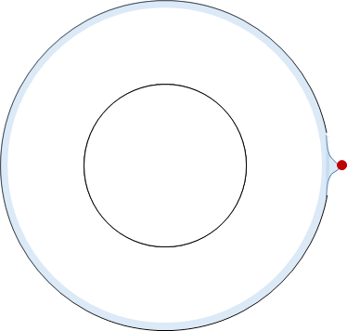
Diversity Propensity
Devices
Narrow Range
Media
Narrow Range
Online Audio
A Propensity
Online Video
Slight Propensity
^{SOURCE: vividata Spring 2019}

Slide 107
Video
Total Canada

Slide 108
Online Video is made up of…
PUREPLAY
On-Demand TV and Movies
NETFLIX
Crave
Amazon Prime Video
COBRANDED
TV Broadcasters
Websites and apps
TV everywhere apps
TV content on YouTube

Slide 109
Quantification is a struggle.
Time counts have been consistent.
Total video reach and time captured.
Video Audience Measurement (VAM).
Ontario/Quebec Panels 2020.
Notes:
Numeris is currently recruiting and building the VAM digital panel, starting with Ontario and Quebec.
They hope to have beta data in the Spring 2019 to present to our BOD in June 2019.

Slide 110
V
Video
Audience
Measurement
A
M

Slide 111

BV
Video Tag
T
Served
Broadcaster Video
S
Devices in/out of Home
BV
S
T
Notes:
The VAM process begins with Broadcasters tagging their digital video content.
When that video is served to a consumer, the consumption of that video content is tracked.

Slide 112





Focal Meter Household Panel
PANEL
CENSUS
1,080
900
O
Q
BV
S
T
T
T
T
Notes:
That served content, along with it’s tag, is captured by comScore and this record of video consumption is called “census”.
Think of it as census traffic running down a train track to comScore.
There are two rail sidings along the way; an Ontario and a Quebec siding.
And these two sidings are special, focal meter equipped, household panels; about 1,000 homes per panel.

Slide 113

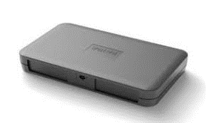
PANEL
CENSUS
O
Q
Notes:
And so we have panel data, that uses a special video detecting focal meter, and a census picture via comScore.

Slide 114
PANEL
CENSUS
Content
Length
Device
Time
Content
Length
Device
Time
FULL DEMO
NO DEMO
IN HOME ONLY
T
TOTAL
OUT of HOME
Notes:
The tagged census data captures the video content, length of the content, the device used and the time spent count.
But no demographic data.
The Panel captures Content, Length, Device and Time, plus full demographic data thanks to a household questionaiire.
While the census data is total data…
… the panel provides an in-home tuning picture only…
… and the subtraction provides the out-of-home video usage picture.

Slide 115



PANEL
PANEL
CENSUS
Content
Length
Device
Time
Content
Length
Device
Time
UNTAGGED
Device
Time
FULL DEMO
FULL DEMO
NO DEMO
IN HOME ONLY
T
TOTAL
NO CONTENT
NO Out of HOME
OUT of HOME
Notes:
The Kantar Focal Meter panels is capable of capturing PurePlay video like YouTube and Netflix and Amazon Prime Video.
But sorry… no tags, no content.
Device and time spent only.
And there will only be an in-home reading.

Slide 116
PANEL
PANEL
PANEL
CENSUS
Pure Play
Time Spent
Broadcaster
Broadcaster
Content
Length
Device
Time
Content
Length
Device
Time
T
T
UNTAGGED
Device
Time
FULL DEMO
FULL DEMO
NO DEMO
IN HOME ONLY
T
TOTAL
NO CONTENT
NO Out of HOME
OUT of HOME
Notes:
In effect, there are three “buckets of data”.
The tagged census data. The tagged panel data and the untagged PurePlay panel data.

Slide 117
PANEL
PANEL
PANEL
CENSUS
Pure Play
Time Spent
Broadcaster
Broadcaster
T
T
PPM
PANEL
Notes:
Enter the Numeris Portable People Meter audience data – the Broadcaster currency.

Slide 118
FUSION
PANEL
PANEL
PANEL
CENSUS
Cross Platform
Viewing Data
Pure Play
Time Spent
Broadcaster
Broadcaster
T
T
PPM
PANEL
Notes:
A fusion of PPM data with the tagged video audience data will create a Cross Platform broadcaster legacy and online Video viewing picture.

Slide 119
CALIBRATION
PANEL
CENSUS
Cross Platform
Viewing Data
Pure Play
Time Spent
Broadcaster
T
Notes:
Which in turn can be calibrated using the “real, census-based” picture of viewing.
Supplemented with an in-home PurePlay time spend count.

Slide 120
VAM
Program audience by full demo.
Unduplicated cross-platform reach (cobrand).
Pure-Play time spent by full demo (in-home).
How should cross-platform viewing be reported?
Numeris hosted Metrics Committee coming soon.
Want more (like timing)?
English https://www.numeriscanada.com/vam_en/ French https://www.numeriscanada.com/vam_fr/

Slide 121
Video is stabilizing.
Total Adult 18+, Weekly
Total Adult 18-34, Weekly
Reach
Minutes/Capita
Reach
Minutes/Capita
Total Online Video
84%
735
97%
1,136
Total PurePlay
70%
560
90%
873
CoBranded
50%
178
55%
263
NETFLIX (in PP)
50%
252
73%
447

Slide 122
100%
90%
80%
WEEKLY REACH %
Stabilizing
Adults 18+
2019 ¹ Weekly Reach/Minutes
ONLINE VIDEO
60%
TV
Radio
Newspaper
Magazine
Internet
OOH
Growing
Total Online Video
PurePlay Video
CoBrand Video
Netflix
84% 735
70% 560
50% 175
50% 252
N
50%
M
N
M
MTM Spring 2019, vividata Spring 2019, PHD Estimates
40%
500
1,000
WEEKLY MINUTES
2,000
3,000

Slide 123
VIDEO
RACIAL MINORITY
ADULTS 18+
Slightly heavier than total adults.
Revenge of the cobrand.
The OTT scramble.

Slide 124
Unearthed

Slide 125
RACIAL MINORITY
INDEXED to
Adults 18+ Total Canada
131
TV
94
WEATHER
128
PODCAST/RADIO
83
SEARCH
98
YOUTUBE
126
HEALTH
99
RECIPIES
100
50
117
MUSIC STREAMING
103
SHORT FORM VIDEO
107
NEWS
115
READ PAPER/MAG
MAPS
111
112
SHOPPING
109
ENTERTAINMENT
^{SOURCE: vividata Spring 2019}

Slide 126
RACIAL MINORITY
INDEXED to
Adults 18+ Total Canada
TV
131
WEATHER
PODCAST/RADIO
SEARCH
83
94
YOUTUBE
128
98
HEALTH
126
RECIPIES
99
MUSIC/TV SKEW
117-131
117
103
MUSIC STREAMING
SHORT FORM VIDEO
115
107
NEWS
112
109
READ PAPER/MAG
111
SHOPPING
MAPS
ENTERTAINMENT
^{SOURCE: vividata Spring 2019}

Slide 127
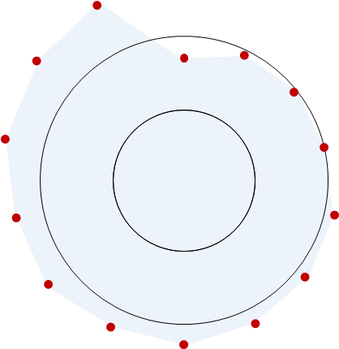
Diversity Propensity
Devices
Narrow Range
Media
Narrow Range
Online Audio
A Propensity
Online Video
Slight Propensity
Unearthed
Wide Propensity
^{SOURCE: vividata Spring 2019}

Slide 128
Unearthed
Total Canada

Slide 129
Total Canada
Adults 18+
Minutes per Capita
Vividata Found
1,376
Notes:
That’s 21 hours per week or 3 hours per day.

Slide 130
Total Canada
Adults 18+
Minutes per Capita
Unearthed
2,067
+50%
Vividata Found
1,376
Notes:
30 hours per week or 4 hours per day.

Slide 131
Total Canada
Adults 18+
Minutes per Capita
Unearthed
2,067
Online
Audio
389
Online
Gaming
20
Video
735
Other
233
Interactive/Text
426
Print
90
Social
138

Slide 132
Total Canada
Adults 18+
Minutes per Capita
Other
233
Online
Audio
389
Online
Gaming
20
Print
90
Social
138
Interactive/Text
426
Video
735
PurePlay
+ Cobrand
Game Console
Wearables
CCars
SSpeakers
FB et al
Podcast
Radio
Streaming
One Way +
Transactional

Slide 133
Total Canada
Adults 18+
Minutes per Capita
Unearthed
2,067
Other
233
Online
Audio
389
Online
Gaming
20
Print
90
Social
138
Interactive/Text
426
Video
735

Slide 134
Total Canada
Adults 18+
Minutes per Capita
Unearthed
2,067
Mobile
944

Slide 135
Total Canada
Adults 18+
Minutes per Capita
Mobile
944
Desktop
589

Slide 136
Total Canada
Adults 18+
Minutes per Capita
Smart
Speakers
40
Game
Console
68
Wear-
ables
100
Desktop
589
Mobile
944
CCars
25
STV
251

Slide 137
Total Canada
Adults 18+
Minutes per Capita
DEVICES
CONTENT
Notes:
Deconstruct the Internet in two ways.
Content and Devices.

Slide 138
100%
90%
80%
WEEKLY REACH %
Adult 18+ 2018 ¹ Weekly Reach/Minutes
UNEARTHED INTERNET
60%
TV
Radio
Newspaper
Magazine
Internet
OOH
UNEARTHED
98% 2,067
N
50%
M
N
M
MTM Spring 2019, eMarketer May ‘19, vivdata Spring 2019, PHD Estimates
40%
500
1,000
WEEKLY MINUTES
2,000
3,000

Slide 139
INTERNET UNEARTHED
RACIAL MINORITY
ADULTS 18+
4 content pieces of note.
33% of Internet unmeasured.
Steady.
New entry points.

Slide 140
Money

Slide 141
RACIAL MINORITY
PROPORTION of
Total Media Expenditure 2018
$13,425
(million)
$279
(million)
Those who don’t know the official languages
= 2%
2%
SOURCE: CRTC 2018 broadcast financial summaries + PHD estimates.

Slide 142
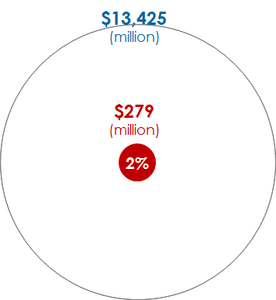
Diversity Propensity
Devices
Narrow Range
Media
Narrow Range
Online Audio
A Propensity
Online Video
Slight Propensity
Unearthed
Wide Propensity
Money
Lacking knowledge of
official languages = 2%
^{SOURCE: vividata Spring 2019}

Slide 143
Money
Total Canada

Slide 144
Ad Revenue $13,300
(Millions, no OOH or ComNewspr)
Minutes 4,526
(Per Capita Weekly Adults 18+ Internet UE)
100%
100%
Total excludes OOH/Com Newspaper. Internet ad revenue from published ThinkTV Ad Rev document for 2018. MpC from 2019 CMUST, Total Canada using Internet Unearthed.

Slide 145
Internet Revenue $7,592
(Millions, 2018)
Internet Minutes 2,067
(Per Capita Weekly Ad 18+ Internet UE 2019)
46%
57%
Internet ad revenue from published ThinkTV Ad Rev document for 2018. MPC from 2018 CMUST using Internet Unearthed.

Slide 146
Internet revenue has become very over-developed.
Internet Revenue $7,592
(Millions, 2018)
Internet Minutes 2,067
(Per Capita Weekly Ad 18+ Internet UE 2019)
46%
57%
Internet ad revenue from published ThinkTV Ad Rev document for 2018. MPC from 2018 CMUST using Internet Unearthed.

Slide 147
Very quickly.
Internet revenue has become very over-developed.
Internet revenue has become very over-developed.
Internet Revenue $7,717
(Millions, 2018)
Internet Minutes 2,067
(Per Capita Weekly Ad 18+ Internet UE 2019)
2015
2019
57%
46%
46%
58%
43%
34%
Share of Time Internet 2015 – 2019 ²
Share of Revenue Internet 2014 – 2018 ¹
Internet ad revenue from published ThinkTV Ad Rev document for 2018. MPC from 2018 CMUST using Internet Unearthed.

Slide 148
Internet Revenue $7,717
(Millions, 2018)
Internet Minutes 2,067
(Per Capita Weekly Ad 18+ Internet UE 2019)
100%
100%
Internet ad revenue from published ThinkTV Ad Rev document for 2018. MPC from 2019 CMUST using Internet Unearthed.

Slide 149
Mobile Revenue $4,792
(Millions)
Mobile Minutes 944
(Per Capita Weekly Ad 18+ Internet UE)
46%
63%
Internet ad revenue from published ThinkTV Ad Rev document for 2018. MPC from 2019 CMUST using Internet Unearthed.

Slide 150
Mobile revenues surpass consumer time.
Mobile Revenue $4,792
(Millions)
Mobile Minutes 949
(Per Capita Weekly Ad 18+ Internet UE)
46%
63%
Internet ad revenue from published ThinkTV Ad Rev document for 2018. MPC from 2019 CMUST using Internet Unearthed.

Slide 151
Video Revenue $1,822
(Millions)
Video Minutes 735
Per Capita Weekly Ad 18+ Internet UE
24%
36%
Internet ad revenue from published ThinkTV Ad Rev document for 2018. MPC from 2019 CMUST using Internet Unearthed.

Slide 152
Video revenue will never catch up to consumer time.
Video Revenue
$1,822 (Millions)
Video Minutes 735
Per Capita Weekly
Ad 18+ Internet UE
24%
36%
Internet ad revenue from published ThinkTV Ad Rev document for 2018. MPC from 2019 CMUST using Internet Unearthed.

Slide 153
Social Revenue $1,320
(Millions)
Social Minutes 138
Per Capita Weekly Ad 18+ Internet UE
17%
7%
Social ad revenue PHD Canada est’d. MPC from 2019 CMUST using Internet Unearthed.

Slide 154
Social revenue is overdeveloped.
Social Revenue
$1,320 (Millions)
Social Minutes
138 MpC wkly
17%
7%
Social ad revenue PHD Canada est’d. MPC from 2019 CMUST using Internet Unearthed.

Slide 155
MONEY
RACIAL MINORITY
ADULTS 18+
2%
Internet overdeveloping quickly.

Slide 156
FIVE IMPLICATIONS

Slide 157
1
New audio marketing frontier is unfolding.
Streamed Music
Podcasting
Radio Online
Audio books
Ear Pods
Smart Speakers

Slide 158
2
A re-evaluation of TV is in play.
The video field is shifting.
Low Value
High Value
Procurement Driven
Globally Driven
Low CPRP
Low Reach
Market Sensitive
Canadian Driven
Higher CPRP
High Reach
CURRENT
Average Level of Branded TV Commercial Recognition ¹
EARLY 2010’s
250 GRP
FROM 36% to 26%
500 GRP
FROM 42% to 31%
1,000 GRP
FROM 47% to 36%
¹ IPSOS Global Tracking Data Base.

Slide 159
CPRPs
TV Revenue 2019

Slide 160
3
Three measurement battles are being waged.
1
Census (clickstream)
vs
Panel (sample)
2
Content
vs
Commercial
3
Industry
vs
Proprietary

Slide 161
4
Internet Revenue is overdeveloping quickly.
Over-Activation? Over-Short-termism? Under-Branding?
How Brands Grow Part 2
Romaniuk/Sharp
Lemon
Wood
Effectiveness in Context
Binet/Field
The Crisis in Creative Effectiveness
Field, 2019
Factors Driving Ad Effectiveness
Ritson
¹ Revenue is one year delayed from time. Share of TV, Radio, Newspaper, Magazine, Internet revenues.
² Internet Share of Time from CMUST studies.

Slide 162
5
The Diversity Conversation.
Ethnic/Mainstream
Cultural Cross-Pollination
Match offer to Settlement Stage
In-language
Appreciation > Comprehension
Migration Nation
Environics Research group
Brown and Cheng

Slide 163
That’s it.
I hope you found
a media “ring of truth” here.

Slide 164
Sources
Popularity of stories
Raptors and comparative TV audiences
Raptor Game 6 Twitter volumes
Toronto geo-fenced pedestrian traffic data
Diversity data
Diversity Actions
Device penetration
TV weekly time/reach, 2019
Radio weekly time/reach , 2019
Internet weekly time/reach , 2019
Magazine weekly time/reach , 2019
Newspaper weekly time/reach , 2019
Out of Home
OOH measurement methodology
Cobranded audio weekly time/reach
Podcast weekly time/reach and tuning dynamics
Streamed music weekly time/reach
Cobranded video
Pureplay video desktop and mobile
Pureplay video smart TV
Netflix
Video Audience Measurement methodology
Internet unearthed
2018 Ad Revenues published
2018 Ad Revenues unpublished
Time spent shares by medium
Ethnic Ad Revenue
Google Trends
Numeris TV PPM Anglo Canada, Toronto EM and Montreal EM.
Twitter Canada, Alyson Gausby,
MicroMarkets, Bell Media, Karen Pettingill.
Stats Canada Census 2016
Migration Nation, Environics Research group, Brown and Cheng
MTM Spring 2019 unless indicated otherwise as PHD estimated.
Numeris, Spring’18/Fall’18 PPM averaged.
Numeris, Fall’18, Diary
Vividata Spring 2019
Vividata Spring 2019, generic question.
Vividata Spring 2019, 72 daily rollup.
Navigator, using PHD estimates of time spent per impression.
COMMB, Rosanne Caron
Numeris PPM Radio Streaming Report shares applied to Radio totals
The Canadian Podcast Listener 2019, Audience Insights Inc., Ulster Media.
MTM Spring 2019, reduced by PHD estimate of respondent over claim.
MTM Spring 2019, reduced PHD estimate of respondent over claim.
Vividata Spring 2019, plus PHD estimates.
MTM Spring ‘19 Pureplay.
MTM Spring 2019
Numeris VAM, Rob Fullerton
Vividata Spring 2019, MTM Spring 2019, eMarketer May 2019, PHD estimates
2018 Annual Ad Expenditures Report, compiled by ThinkTV, Kathy Gardner
PHD estimates
Time spent as summarized in CMUST 2019
2018 CRTC Radio and Discretionary Service actuals + PHD estimates for balance.

Slide 167
GAME 6
Adults 18+, Anglo Canada
30
25
20
15
Superbowl
10.9
RATING
Grey Cup
10.8
10
Game of Thrones (8)
8.0
World Juniors
7.1
Academy Awards
6.4
5
THURSDAY
JUNE 13th

Slide 168
GAME 6
Adults 18+, Anglo Canada
30
Adults 18+, Toronto
Superbowl
25
24.2
Academy Awards
19.4
20
Big Bang Theory
17.4
15
Golden Globes
11.6
Superbowl
10.9
RATING
Grey Cup
10.8
Game of Thrones (8)
10.6
10
Game of Thrones (8)
8.0
World Juniors
7.1
Academy Awards
6.4
5
THURSDAY
JUNE 13th

Slide 169
PLAYOFFS
30
Adults 18+, Anglo Canada
Adults 18+, Toronto
25
1.7
X’s
20
15
RATING
10
5
2.5
X’s
Week Sunday 2019
7
14
21
28
5
12
19
26
2
9
APRIL
MAY
JUNE

Slide 170
Contextualizing Podcasts.
Who’s doing what?
ADULTS 18+ Total Canada
NEW 12%
MONTHLY LISTENERS 26%
TENURED 3%
WEEKLY LISTENERS 17%
POWER 7%
Source: The Canadian Podcast Listener 2019
Total Canada 18+ (n=3,040) Monthly Podcast Listeners (n = 1,538)
Power Listeners spend 5+ hours per week with Podcasts.
New Listeners first started listening to Podcasts a year ago of more recently.
Tenured Listeners have been listening to Podcasts for 5 or more years now.

