Slide 1
C
Canadian
Media
Usage
STudy
M
U
ST
Total Canada
Rob Young
PHD Canada, November 2018

Slide 2








Stories

Slide 3
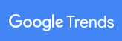
Google Trends Stories
from “Bummer Summer” 2018
100
50
June 4th
July 3rd
August 1st
Sept 2nd

Slide 4
CELEBRITY POLITICS
100
50
June 4th
July 3rd
August 1st
Sept 2nd
Notes:
Trump/Kim Jong Un Summit
Issue statements on June 11th 2018

Slide 5
CONFLICT
100
50
June 4th
July 3rd
August 1st
Sept 2nd
Notes:
Trans Mountain shut down by Federal Court
Decision announced August 30 2018

Slide 6
SCHADENFREUDE
100
50
June 4th
July 3rd
August 1st
Sept 2nd
Notes:
Omarosa Fired from the White House job triggering another book about Trump.
August 12 2018
Schadenfreude means pleasure derived from other’s misfortune.
A favourite Story theme as you’ll see.
Pronounced SHA DEN FROI DA

Slide 7
DISASTER
100
50
June 4th
July 3rd
August 1st
Sept 2nd
Notes:
BC Wildfires
June/July 2018

Slide 8
CELEBRITY POLITICS
100
50
June 4th
July 3rd
August 1st
Sept 2nd
Notes:
Trump Putin Meet
July 17 2018

Slide 9
SCHADENFREUDE
100
50
June 4th
July 3rd
August 1st
Sept 2nd
Notes:
Michael Cohen Pleads Guilty
August 21 2018

Slide 10
CONFLICT
100
50
June 4th
July 3rd
August 1st
Sept 2nd
Notes:
Saudi Arabia/Canada Spat
August 7 2018

Slide 11
SCHADENFREUDE
100
50
June 4th
July 3rd
August 1st
Sept 2nd
Notes:
Manafort found guilty on 8 counts
August 21 2018

Slide 12
DISASTER
100
50
June 4th
July 3rd
August 1st
Sept 2nd
Notes:
Thai Cave Rescue
Last one out July 10 2018

Slide 13
CELEBRITY POLITICS
100
50
June 4th
July 3rd
August 1st
Sept 2nd
Notes:
Doug Ford Wins Ontario
June 8 2018

Slide 14
CELEBRITY DEATH
100
50
June 4th
July 3rd
August 1st
Sept 2nd
Notes:
Aretha Franklin dies/funeral
August 16/September 1 2018

Slide 15
CELEBRITY DEATH
100
50
June 4th
July 3rd
August 1st
Sept 2nd
Notes:
John McCain dies/funeral
August 26/September 2 2018

Slide 16
CELEBRITY SUICIDE
100
50
June 4th
July 3rd
August 1st
Sept 2nd
Notes:
Kate Spade commits suicide
June 6 2018

Slide 17
CELEBRITY SUICIDE
100
50
June 4th
July 3rd
August 1st
Sept 2nd
Notes:
Anthony Bourdain commits suicide
June 8 2018

Slide 18
SPORTS
100
50
June 4th
July 3rd
August 1st
Sept 2nd
Notes:
World Cup
June 14 – July 15 2018

Slide 19
SCHADEN-
FREUDE
CELEBRITY
POLITICS
CELEBRITY
DEATH
CELEBRITY
SUICIDE
DISASTER
CONFLICT
SPORTS

Slide 20
Story Quant.
Story Qual.
Brand Safety.
Notes:
That was about Story Quant.
There has been rising concern about the nature and quality of the stories that house our media advertising messages.
We need to think about Story Quant, yes, but we also need to pay attention to Story Qual.
We have a term for this concern… Brand Safety.

Slide 21
Can high quality stories build brands?
Actually yes.
Story context matters.
Notes:
Some recent and important research was conducted to address this question.
Can high quality stories build brands?
As you’d suspect, the result of this research confirms that, yes, the quality of story context matters.

Slide 22
"The Evolution of Contextual Targeting”
Using brain data to get ad placement right
Oath Canada
YouGov
Brainsights Neuro Study
English and French, Spring 2018
Adults 18+, 1,015 sample, online study, E+F
300 sample, attention, connection, encoding.
Notes:
"The Evolution of Contextual Targeting” is the name of the report containing the results of this study.
It was conducted by Oath Canada in Spring 2018 against English and French adults 18+
They employed YouGov to administer an online survey amongst over 1,000 respondents.
And they employed Brainsights to conduct a Neuro study amongst 300 respondents.

Slide 23
“I feel less favourable
towards the brand…”
Ads in high quality content,
when compared to “normal” content…
Overall
Mobile
Video
69%
… increase my attention.
ATTENTION(0-100)
… if their ads are next to offensive content.”
… capture a deeper relationship.
CONNECTION (0-100)
100
67%
… encoded to memory better.
ENCODING (0-100)
… if their ads are next to lower quality/click bait content.”
100
121
107
110
170
142
153
176
202
YouGov Survey Results
Brainsight Neural Scores
Notes:
“I feel less favourable towards the brand…” was the sentiment expressed by 69% of respondents to brand ads appearing next to offensive content.
And the sentiment expressed by 67% of respondents concerning brand ads appearing next to lower quality, click bait–like content.
According to the Brainsights portion of the study, ads in high quality content, when compared to normal content…
Did not increase attention overall, but increases in attention were noted amongst ads on mobile devises and video ads.
Higher quality content produced deeper relationship connections…
And produced better memory encoding.

Slide 24
Brand Safe content matters.
Notes:
Which all goes to say… Brand Safety content matters to the effectiveness of your campaign.

Slide 25
Those were stories in the media.
Now some stories about the media.

Slide 26
Devices
Media
E-Commerce
Audio
Video
Commercials
Unearthed
Money
Actions

Slide 27

Devices
“All this happened, more or less.”
Slaughterhouse-Five
Kurt Vonnegut
1969
Notes:
Slaughterhouse-Five, or The Children's Crusade: A Duty-Dance with Death (1969) is a science fiction-infused anti-war novel by Kurt Vonnegut about the World War II experiences and journeys through time of Billy Pilgrim, from his time as an American soldier and chaplain's assistant, to postwar and early years. It is generally recognized as Vonnegut's most influential and popular work.^{[2]} A central event is Pilgrim's surviving the Allies' firebombing of Dresden as a prisoner-of-war. This was an event in Vonnegut's own life, and the novel is considered semi-autobiographical.

Slide 28





9
Devices
STV

Slide 29
9
Devices
18+
18+
18-34
100%
STV
50%
2013
2014
2015
2016
2017
2018

Slide 30
Internet Accessing Device Usage, amongst Adults
18+
18+
18-34
100%
88%/91%
Desk/Laptop
STV
50%
Spring Surveys, MTM
2013
2014
2015
2016
2017
2018

Slide 31
Internet Accessing Device Usage, amongst Adults
18+
18+
18-34
100%
82%/96%
Smart Phone
STV
50%
SP = Spring Surveys, MTM
2013
2014
2015
2016
2017
2018

Slide 32
Internet Accessing Device Usage, amongst Adults
18+
18+
18-34
100%
STV
58%/54%
Tablet
50%
SP = Spring Surveys, MTM
2013
2014
2015
2016
2017
2018

Slide 33
Internet Accessing Device Usage, amongst Adults
18+
18+
18-34
100%
STV
50%
50%/52%
Smart TV
SP = Spring Surveys, MTM
2013
2014
2015
2016
2017
2018

Slide 34
Internet Accessing Device Usage, amongst Adults
18+
18+
18-34
100%
STV
50%
50%/52%
Smart TV
14%/23%
Computer
10%/11%
AppleTV
7%/13%
Chromecast
3%/1%
Roku
1%/1%
FireStick
SP = Spring Surveys, MTM
2013
2014
2015
2016
2017
2018

Slide 35
Internet Accessing Device Usage, amongst Adults
18+
18+
18-34
100%
STV
50%
33%/35%
Four Screens
SP = Spring Surveys, MTM
2013
2014
2015
2016
2017
2018

Slide 36
Internet Accessing Device Usage, amongst Adults
18+
18+
18-34
100%
STV
50%
50%/71%
Game Console
SP = Spring Surveys, MTM
2013
2014
2015
2016
2017
2018

Slide 37
Internet Accessing Device Usage, amongst Adults
18+
18+
18-34
100%
STV
50%
26%/29%
Wearables
16%/17%
FitBit
4%/ 2%
AppleWatch
SP = Spring Surveys, MTM
2013
2014
2015
2016
2017
2018

Slide 38
Internet Accessing Device Usage, amongst Adults
18+
18+
18-34
100%
STV
50%
8%/8%
Car Connectivity
2013
2014
2015
2016
2017
2018
https://mobilesyrup.com/2017/11/22/canada-behind-us-uk-connected-car-technology/

Slide 39
Internet Accessing Device Usage, amongst Adults
18+
18+
18-34
100%
STV
50%
5%/5%
VR Headset
SP = Spring Surveys, MTM
2013
2014
2015
2016
2017
2018
Notes:
This is VR. Augmented Reality appears to have more applications, application and usage.

Slide 40
Internet Accessing Device Usage, amongst Adults
18+
18+
18-34
100%
STV
50%
8%/12%
Smart Speakers
5%/6%
Google Home
2%/3%
Amazon Echo
SP = Spring Surveys, MTM
2013
2014
2015
2016
2017
2018
Notes:
Coming out of 2018 with penetration in the mid teens.
Carries significant implications which we discuss end of this presentation.

Slide 41
Internet Accessing Device Usage, amongst Adults
18+
18+
18-34
100%
88%/91%
Desk/Laptop
82%/96%
Smart Phone
STV
58%/54%
Tablet
50%
50%/71%
Game Console
50%/52%
Smart TV
26%/29%
Wearables
8%/12%
Smart Speakers
8%/8%
Car Connectivity
5%/5%
VR Headset
SP = Spring Surveys, MTM
2013
2014
2015
2016
2017
2018

Slide 42

Device Penetration and Potential
LOW
Growth Potential
HIGH
DEEP
STV
Penetration
SHALLOW

Slide 43
DEVICES WITH GREATEST GROWTH POTENTIAL
Tethering erodes auto manufacturer’s connectivity.
Smart TV, Wearable Watches, Smart Speakers growing.

Slide 44

Media
“Time is not a line but a dimension, like the dimension of space.”
Cat’s Eye
Margret Atwood
1988
Notes:
Cat's Eye is a 1988 novel by Canadian writer Margaret Atwood about controversial painter Elaine Risley, who vividly reflects on her childhood and teenage years. Her strongest memories are of Cordelia, who was the leader of a trio of girls who were both very cruel and very kind to her in ways that tint Elaine's perceptions of relationships and her world — not to mention her art — into her middle years. The novel unfolds in mid-20th century Canada, from World War II to the late 1980s, and includes a look at many of the cultural elements of that time period, including feminism and various modern art movements. The book was a finalist for the 1988 Governor General's Award and for the 1989 Booker Prize.

Slide 45
100%
90%
NUMERIS
TV/Radio
80%
VIVIDATA
NEWSPAPER/MAGAZINE
WEEKLY REACH %
comScore
INTERNET
Navigator
OUT of HOME
60%
50%
40%
500
1,000
WEEKLY MINUTES
2,000
3,000

Slide 46
100%
90%
80%
WEEKLY REACH %
Adults Weekly Reach/Minutes
60%
2001
TV
A
L+7
96% 1,531
50%
40%
500
1,000
WEEKLY MINUTES
2,000
3,000

Slide 47
100%
90%
80%
WEEKLY REACH %
Adults Weekly Reach/Minutes
60%
2001
TV
A
96% 1,531
50%
40%
500
1,000
WEEKLY MINUTES
2,000
3,000

Slide 48
100%
A
90%
A
80%
A
WEEKLY REACH %
Adults Weekly Reach/Minutes
60%
2001
TV
A
96% 1,531
RADIO
NEWSPAPER
MAGAZINE
INTERNET
94% 1,282
82% 184
73% 77
52% 311
A
A
A
A
50%
A
40%
500
1,000
WEEKLY MINUTES
2,000
3,000

Slide 49
100%
A
90%
A
80%
A
WEEKLY REACH %
Adults Weekly Reach/Minutes
60%
2001
2017
TV
A
96% 1,531
97% 1,632
RADIO
NEWSPAPER
MAGAZINE
INTERNET
94% 1,282
82% 184
73% 77
52% 311
88% 913
54% 64
54% 20
91% 1,266
A
A
A
A
50%
A
40%
500
1,000
WEEKLY MINUTES
2,000
3,000

Slide 50
100%
A
90%
A
80%
A
WEEKLY REACH %
Adults Weekly Reach/Minutes
60%
2001
2017
TV
A
96% 1,531
97% 1,632
RADIO
NEWSPAPER
MAGAZINE
INTERNET
94% 1,282
82% 184
73% 77
52% 311
88% 913
54% 64
54% 20
91% 1,266
A
A
A
A
50%
A
40%
500
1,000
WEEKLY MINUTES
2,000
3,000

Slide 51
100%
90%
80%
WEEKLY REACH %
Adults Weekly Reach/Minutes
60%
2017
2018
TV
97% 1,632
95% 1,554
RADIO
NEWSPAPER
MAGAZINE
INTERNET
88% 913
54% 64
54% 20
91% 1,266
87% 903
52% 59
51% 18
90% 1,328
50%
40%
500
1,000
WEEKLY MINUTES
2,000
3,000

Slide 52
100%
90%
Older, 55+ stable viewers.
80%
WEEKLY REACH %
Adults 2018 Weekly Reach/Minutes
TV
60%
18+
18-24
25-34
35-54
55+
95% 1,554
91% 876
90% 888
95% 1,254
98% 2,304
50%
Sp/Fall 2017
40%
500
1,000
WEEKLY MINUTES
2,000
3,000

Slide 53
100%
90%
80%
The 18-24 year old gets lighter once again.
WEEKLY REACH %
Adults 2018 Weekly Reach/Minutes
RADIO
60%
18+
87% 902
18-24
25-34
35-54
55+
73% 453
84% 704
92% 921
89% 1,110
50%
Fall 2017 Numeris
40%
500
1,000
WEEKLY MINUTES
2,000
3,000

Slide 54
100%
90%
80%
WEEKLY REACH %
Adults 2018 Weekly Reach/Minutes
NEWSPAPER
60%
Older demo, heaviest reader.
18+
52% 59
18-24
25-34
35-54
55+
48% 30
48% 40
50% 44
57% 92
50%
Spring 2018 Vividata
40%
500
1,000
WEEKLY MINUTES
2,000
3,000

Slide 55
100%
90%
80%
WEEKLY REACH %
Adults 2018 Weekly Reach/Minutes
MAGAZINE
Older demo is the heaviest Magazine reader.
60%
18+
51% 18
18-24
25-34
35-54
55+
37% 11
39% 11
49% 18
61% 24
50%
Spring 2018 Vividata
40%
500
1,000
WEEKLY MINUTES
2,000
3,000

Slide 56
100%
90%
Strong youth skew.
80%
WEEKLY REACH %
55+ year old adults still
light Internet users.
Adults 2018 Weekly Reach/Minutes
INTERNET
60%
18+
90% 1,328
18-24
25-34
35-54
55+
96% 1,741
98% 1,596
100% 1,703
72% 747
50%
July 2018 comScore
40%
500
1,000
WEEKLY MINUTES
2,000
3,000

Slide 57
100%
Heavier tuners
Deeper reach
90%
A bit deeper and heavier
80%
WEEKLY REACH %
Deeper reach
60%
French Adults 18+ 2018 Weekly Reach + Minutes
INTERNET
MAGAZINE
NEWSPAPER
RADIO
TV
50%
94% 1,319
48% 19
61% 69
88% 949
97% 1,926
Less reach
July 2018 comScore
Spring 2018 Vividata
Spring 2018 Vividata
Fall 2017 Numeris
Sp/Fall 2017 Numeris
40%
500
1,000
WEEKLY MINUTES
2,000
3,000

Slide 58
100%
90%
A
2019… The end of the old “car counting” methodology
Toronto/Vancouver. National in 2020.
80%
WEEKLY REACH %
Adults Weekly Reach/Minutes
OUT of HOME
60%
TV
Radio
Newspaper
Magazine
Internet
18+
A
85% 80
18-24
25-34
35-54
55+
80% 70
82% 75
86% 85
90% 90
50%
^{Navigator}
40%
500
1,000
WEEKLY MINUTES
2,000
3,000
Notes:
If approved, the new measurement approach could replace the current measurement methodology for Toronto and Vancouver in 2019. The national dataset would follow in 2020.

Slide 59
LEGACY MEDIA OLDER SKEWING
Some additional declines this year.
OOH moving to new measurement.
Internet continues to grow, but not as quickly.
Notes:
If approved, the new OOH measurement approach could replace the current measurement methodology for Toronto and Vancouver in 2019. The national dataset would follow in 2020.

Slide 60

E-commerce
“It was the best of times,
it was the worst of times…”
A Tale of Two Cities
Charles Dickens
1859
Notes:
A Tale of Two Cities (1859) is a historical novel by Charles Dickens, set in London and Paris before and during the French Revolution. The novel tells the story of the French Doctor Manette, his 18-year-long imprisonment in the Bastille in Paris and his release to live in London with his daughter Lucie, whom he had never met. The story is set against the conditions that led up to the French Revolution and the Reign of Terror.

Slide 61
Annual Retail Sales in Canada = $588.8 billion.
And E-Commerce = 2.7% of Retail Sales.
(Stats Canada 2017)
Therefore E-Commerce = $16 billion.
(Stats Canada 2017)

Slide 62
Of the $16 billion in E-Commerce revenue…
All
E-Sites
$16 billion

Slide 63
81% or $13 billion is spent on the top 11 E-Sites…
All
E-Sites
Top
11 E-Sites
$16 billion
$13 billion

Slide 64
and of this, 54% is spent on the top E-Site.
All
E-Sites
Top
11 E-Sites
Top
E-Site
$16 billion
$13 billion
$7 billion
Notes:
Top 12 Retail Domains
Amazon.ca
Walmart.ca
Ebay.ca
Homedepot.ca
Bestbuy.ca
Costco.ca
Ticketmaster.ca
Staples.ca
Gapcanada.ca
Indigo.ca
Toysrus.ca

Slide 65
85% of adults 18+ visit an E-Commerce site weekly.
Visit All
E-Sites
85%

Slide 66
69% of adults 18+ visit the top 11 sites,
and 52% visit the top E-Site weekly.
Visit All
E-Sites
Visit Top
11 E-Sites
Visit Top
E-Site
85%
69%
52%

Slide 67
Of those visiting the top 11 E-Sites weekly,
a fifth or 15% of adults purchase something.
Visit All
E-Sites
Visit Top
11 E-Sites
Visit Top
E-Site
Purchase on
Top 11 E-Sites
85%
69%
52%
15%

Slide 68
Of those visiting the top E-Site,
a fifth or 10% of adults 18+ purchase something weekly.
Visit Top
11 E-Sites
Visit Top
E-Site
Purchase on
Top 11 E-Sites
Purchase on
Top E-Site
69%
52%
15%
10%

Slide 69
The E-Comm funnel.
From weekly reach,
to weekly purchase.
Visit All
E-Sites
Visit Top
11 E-Sites
Visit Top
E-Site
Purchase on
Top 11 E-Sites
Purchase on
Top E-Site
85%
69%
52%
15%
10%

Slide 70
49 minutes per week per capita.
That’s the time adults spend on E-Com sites.
Visit All
E-Sites
49 minutes

Slide 71
That funnels down to 6 and 3 minutes per capita
for the top E-Sites.
Visit All
E-Sites
Visit Top
11 E-Sites
Visit Top
E-Site
49 minutes
6 minutes
3 minutes

Slide 72
100%
90%
A
80%
Screen shopping and purchasing is the only real content.
WEEKLY REACH %
60%
Adults 2017 ¹ Weekly Reach/Minutes
E-Commerce
TV
Radio
Newspaper
Magazine
Internet
OOH
N
18+
E
85% 49
M
50%
comScore, Emarketer, Stats Canada
40%
500
1,000
WEEKLY MINUTES
2,000
3,000

Slide 73
E-COMMERCE IS UBIQUITOUS
Reaches most consumers.
20% reach to purchase conversion rate.

Slide 74

Audio
“If you really want to hear about it…”
The Catcher in the Rye
J.D. Salinger
1951
Notes:
The Catcher in the Rye is a story by J. D. Salinger, partially published in serial form in 1945–1946 and as a novel in 1951.^{[3]} A classic novel originally published for adults, it has since become popular with adolescent readers for its themes of teenage angstand alienation.^{[4][5]} It has been translated into almost all of the world's major languages.^{[6]} Around 1 million copies are sold each year, with total sales of more than 65 million books.^{[7]} The novel's protagonist Holden Caulfield has become an icon for teenage rebellion.^{[8]} The novel also deals with complex issues of innocence, identity, belonging, loss, and connection.

Slide 75
Online Audio is made up of…
Music streaming free and paid subscription.
This includes music consumed on YouTube.
Podcasts.
AM and FM Online Radio.

Slide 76




Gaining Clarity
Likely an overstatement of time spent counts.
Little/no measurement of Podcasts and Online Radio.
Online tests conducted. First wave of data now released.
The Canadian
Podcast Listener
2018
In-depth examination of Podcast reach, time, downloads.

Slide 77
Online Audio reach and time grew this year.
Adult 18+, Weekly
Adult 18-34, Weekly
Reach
Minutes/Capita
Reach
Minutes/Capita
50%
100
50%
100
Total Online Audio
65%
135
85%
185
Streamed Music
60%
90
80%
135
Podcasts
20%
25
30%
30
Radio Online
10%
20
10%
20
"The Canadian Podcast Listener 2018, Audience Insights Inc., Ulster Media (May/June, 2018)"
Weekly Reach/Min per Listener/Mins Per Capita
Total Canada Ad 18+= 18%/373/67
Ad 18-34 = 33%/404/133
Weekly Reach/Min per Listener/Mins Per Capita
Fr Canada Ad 18+= 13%/404/53
Ad 18-34 = na

Slide 78

The Podcast “Long Tail”.
The aggregation of micro-casts.
6%
% listening
to a podcast
monthly
1%
200
500
1,000
1,500
1,831
Number of Podcasts
Source: The Canadian Podcast Listener 2018
Please list up to 10 podcasts you remember listening to in the past month.
Base: Monthly podcast listeners, aged 18+ (n=1,534)

Slide 79
100%
90%
A
80%
WEEKLY REACH %
Developing quickly.
Adults 18+
2017 ¹ Weekly Reach/Minutes
ONLINE AUDIO
60%
TV
Radio
Newspaper
Magazine
Internet
OOH
Total Online Audio
65% 135
N
50%
M
MTM Spring 2017, comScore, PHD Estimates
40%
500
1,000
WEEKLY MINUTES
2,000
3,000

Slide 80
ONLINE AUDIO
Consumer uptake is accelerating.
Now past the point of critical mass.
Podcast buying infrastructure in place.

Slide 81

Video
“The sky above the port
was the color of television…”
Neuromancer
William Gibson
1984
Notes:
Neuromancer is a 1984 science fiction novel by American-Canadian writer William Gibson. It is one of the best-known works in the cyberpunk genre and the first novel to win the Nebula Award, the Philip K. Dick Award, and the Hugo Award.^{[1]} It was Gibson's debut novel and the beginning of the Sprawl trilogy. The novel tells the near-future story of Case, a washed-up computer hackerhired by a mysterious employer for one last job against a powerful artificial intelligence.

Slide 82
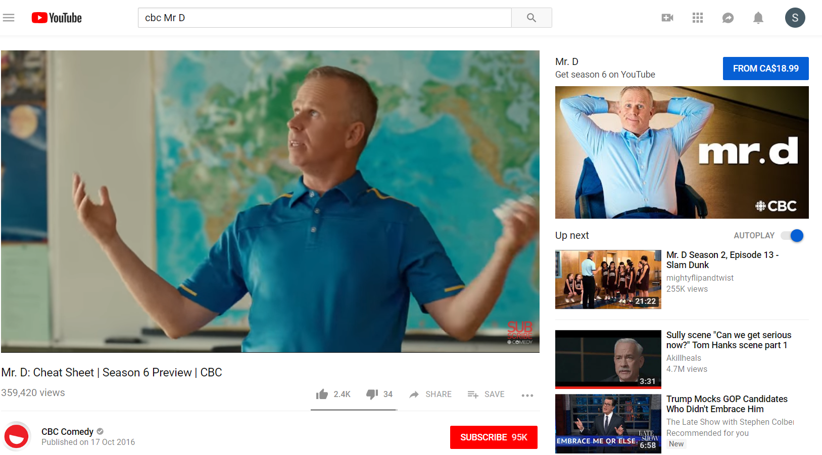
Online Video is made up of…
PUREPLAY
On-Demand TV and Movies
NETFLIX
Crave
Amazon Prime Video
COBRANDED
TV Broadcasters
Websites and apps
TV everywhere apps
Content on YouTube

Slide 83
Under constant exploration.
Probably overstates time counts.
Partial tagging of mobile video.
No Smart TV measurement.
Video Audience Measurement (VAM).
Ontario/Quebec Beta Spring 2019.
Notes:
Numeris is currently recruiting and building the VAM digital panel, starting with Ontario and Quebec.
They hope to have beta data in the Spring 2019 to present to our BOD in June 2019.

Slide 84
Relying on two rough maps. ComScore and MTM.
Adult 18+, Weekly
Adult 18-34, Weekly
Reach
Minutes/Capita
Reach
Minutes/Capita
50%
500
50%
500
Total Online Video
85%
777
97%
1,302
Total PurePlay
70%
619
90%
1,039
CoBranded
42%
158
50%
263
NETFLIX (in PP)
49%
250
72%
500

Slide 85

2017
56%
18-34
WATCH
VIA STV
18+
63%
WATCH
WEEKLY
WATCH VIA
DESKTOP
WATCH
MONTHLY
WATCH
VIA SP
67%
38%
36%
31%
SUBSCRIBE
42%
28%
WATCH VIA
TABLET
47%
16%
21%
10%
11%
13%
10%
20%
30%
40%
50%
MTM Survey Spring 2017

Slide 86
72%
2018
72%
56%
18-34
WATCH
VIA STV
18+
63%
WATCH
WEEKLY
WATCH VIA
DESKTOP
49%
45%
47%
75%
WATCH
MONTHLY
WATCH
VIA SP
67%
50%
38%
35%
36%
31%
SUBSCRIBE
42%
28%
WATCH VIA
TABLET
54%
32%
47%
21%
16%
21%
16%
10%
14%
19%
11%
13%
10%
20%
30%
40%
50%
MTM Survey Spring 2017

Slide 87
100%
90%
A
80%
WEEKLY REACH %
Adults 18+
2017 ¹ Weekly Reach/Minutes
ONLINE VIDEO
60%
TV
Radio
Newspaper
Magazine
Internet
OOH
Total Online Video
PurePlay Video
CoBrand Video
Netflix
85% 777
70% 619
42% 158
49% 250
More minutes than one would expect
N
50%
M
MTM Spring 2017, comScore, PHD Estimates
40%
500
1,000
WEEKLY MINUTES
2,000
3,000

Slide 88
ONLINE VIDEO/OTT
We’re all screaming for more streaming.
Broadcasters move aggressively on cobranding.
And consumers are responding.

Slide 89

Commercials
“It was love at first sight.”
Catch 22
Joseph Heller
1961
Notes:
Catch-22 is a satirical novel by American author Joseph Heller. He began writing it in 1953; the novel was first published in 1961. Often cited as one of the most significant novels of the twentieth century,^{[2]} it uses a distinctive non-chronological third-person omniscient narration, describing events from the points of view of different characters. The separate storylines are out of sequence so the timeline develops along with the plot.

Slide 90


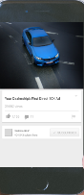

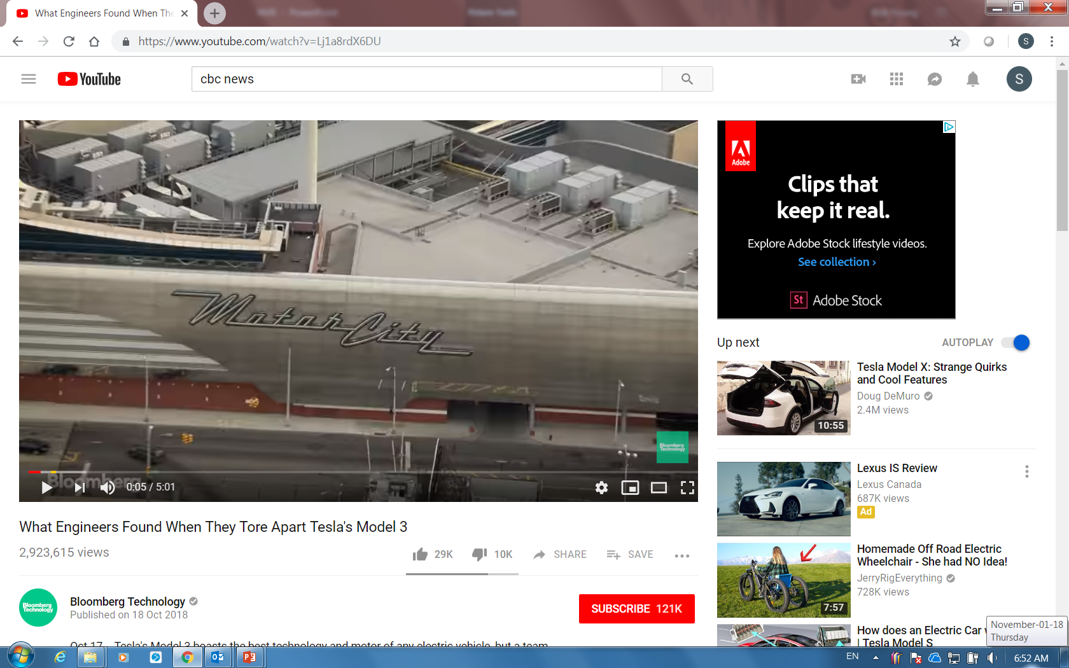

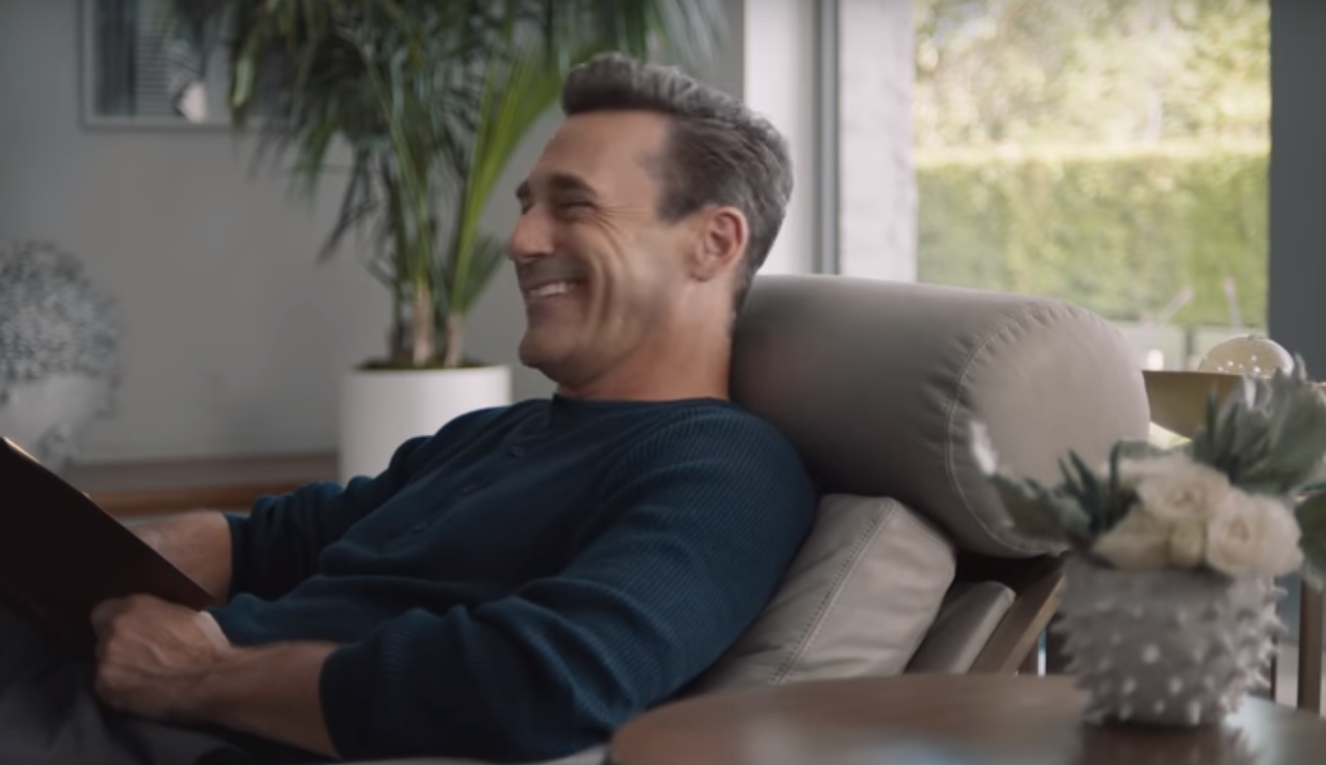
The Rosetta Stone
(196 bc)
3 languages.
Same story.
3 commercial channels.
Same impact?
Notes:
Rediscovered 1799 by a French soldier in the Nile delta by a French soldier during the Napoleonic campaign in Egypt. In 1801, following the defeat of the French by British troops in Egypt, the stone was removed to the British museum where it is displayed to this very day.
Greek text
Demotic text
Hieroglyphic text

Slide 91
VIDEO COMMERCIALS
Are they inherently more or less effective
when viewed on different devices?
TV, PC, Mobile

Slide 92
Effective?
We mean product interest, comprehension,
and eye focus.

Slide 93
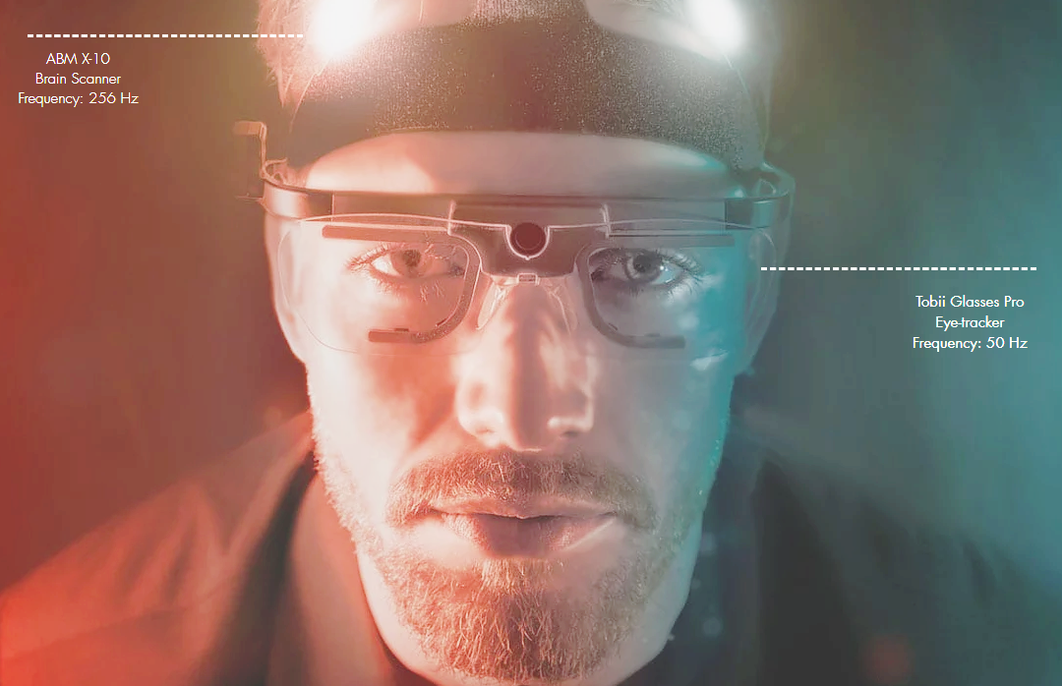
The Study Details
2018
Fall
6
Days
3
Rooms
8am
8pm
50/50
Male/Female
120
Respondents
3
Devices
12
Commercials

Slide 94
The Scores indexed to TV (100)
Proportion of commercial time spent
actually viewing the commercial.
FIXATION DURATION (%)
TV
PC
Mobile
100
Comprehension and learning
without overloading.
COGNITIVE FOCUS (0-100)
Interest in and desire for the product
being advertised.
MOTIVATION (0-100)
The average of these
three key scores.
AVERAGE (0-100)

Slide 95
So the answer to the question…
Are video commercials inherently more or less effective
when viewed on TV, PC, Mobile is...

Slide 96
Not really!

Slide 97
What about Live and Regular Programming TV
indexed to TV (100)?
Proportion of commercial time spent
actually viewing the commercial.
FIXATION DURATION (%)
TV
TV^{L}
TV^{P}
100
Comprehension and learning
without overloading.
COGNITIVE FOCUS (0-100)
Interest in and desire for the product
being advertised.
MOTIVATION (0-100)
The average of these
three key scores.
AVERAGE (0-100)

Slide 98
So the answer to the question…
Are TV commercials inherently more or less effective
when viewed in Live vs Regular Programming...

Slide 99
Not really!

Slide 100
VIDEO COMMERCIALS
Device AD-nostic.

Slide 101

Unearthed
“In a hole in the ground there lived a hobbit.”
The Hobbit
J.R.R. Tolkien
1937
Notes:
The Hobbit, or There and Back Again
Author J. R. R. Tolkien IllustratorJ. R. R. TolkienCover artistJ. R. R. TolkienCountryUnited KingdomLanguageEnglishSubjectTolkien's legendariumGenreHigh fantasy
Juvenile fantasy
Set inMiddle-earthPublisherGeorge Allen & Unwin (UK)Publication date
21 September 1937Pages310 (first edition)OCLC1827184LC ClassPR6039.O32 H63Followed byThe Lord of the RingsThe Hobbit, or There and Back Again is a children's fantasy novel by English author J. R. R. Tolkien. It was published on 21 September 1937 to wide critical acclaim, being nominated for the Carnegie Medal and awarded a prize from the New York Herald Tribune for best juvenile fiction. The book remains popular and is recognized as a classic in children's literature.

Slide 102
Minutes per Capita
Total Canada
Adults 18+
comScore Found
1,328
Notes:
That’s 21 hours per week or 3 hours per day.

Slide 103
Minutes per Capita
Total Canada
Adults 18+
Unearthed
2,154
+62%
comScore Found
1,328
Notes:
30 hours per week or 4 hours per day.

Slide 104
Minutes per Capita
Total Canada
Adults 18+
Online
Audio
135
Online
Gaming
56
Interactive
169
Print
77
Video
777
Other
250
Text
479
Unearthed
2,154
Social
211

Slide 105
Minutes per Capita
Total Canada
Adults 18+
Online
Gaming
56
Online
Audio
135
Print
77
Interactive
169
Social
211
Other
250
Text
479
Video
777
PurePlay
+ Cobrand
Allocated
From:
Game Console
Wearables
Ccars
SSpeakers
Podcast
Radio
Streaming
FB et al
Banking
Buying
Trading
OneWay
Notes:
Social MPC is a non-video number

Slide 106
Minutes per Capita
Total Canada
Adults 18+
Online
Gaming
56
Online
Audio
135
Unearthed
2,154
Print
77
Interactive
169
Other
211
Social
250
Text
479
Video
777

Slide 107
Minutes per Capita
Total Canada
Adults 18+
Mobile
1,204
Unearthed
2,154

Slide 108
Minutes per Capita
Total Canada
Adults 18+
Mobile
1,204
Video
327
Mobile
1,204
NonVideo
877

Slide 109
Minutes per Capita
Total Canada
Adults 18+
Mobile
1,204
Video
327
27%
NonVideo
877
73%

Slide 110
Minutes per Capita
Total Canada
Adults 18+
Mobile
1,204
DeskTop
450
Video
327
27%
Video
200
NonVideo
877
NonVideo
250
73%

Slide 111
Minutes per Capita
Total Canada
Adults 18+
Mobile
1,204
DeskTop
450
Video
327
Video
200
27%
44%
NonVideo
877
NonVideo
250
73%
56%

Slide 112
Minutes per Capita
Total Canada
Adults 18+
Mobile
1,204
DeskTop
450
STV
250 Video
Video
327
Video
200
27%
44%
NonVideo
877
NonVideo
250
73%
56%

Slide 113
Minutes per Capita
Total Canada
Adults 18+
Mobile
1,204
DeskTop
450
Wear-
ables
137
STV
250 Video
Game
Console
68
Video
327
Smart
Speakers
20
CCars
25
UM
Video
200
27%
UM
UM
UM
UM
UM
44%
NonVideo
877
NonVideo
250
73%
56%
UM
UNMEASURED

Slide 114
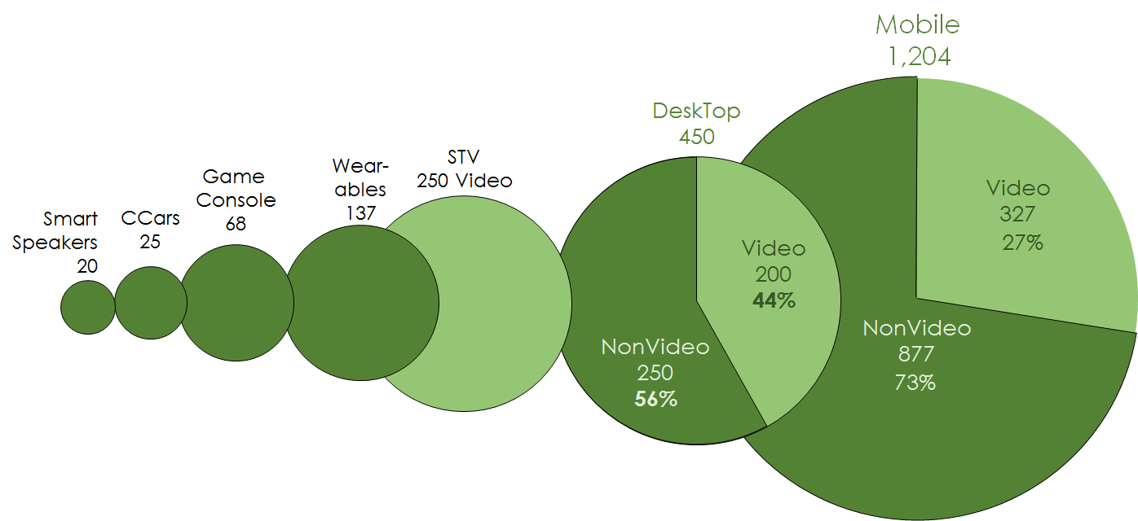
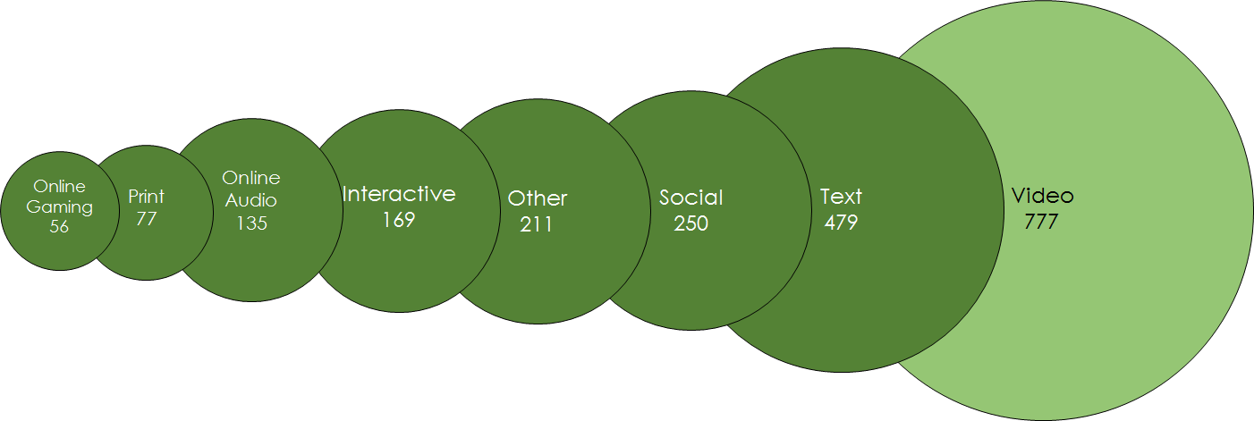
Minutes per Capita
Total Canada
Adults 18+
DEVICES
CONTENT
Notes:
Deconstruct the Internet in two ways.
Content and Devices.

Slide 115
Minutes per Capita
Total Canada
Adults 18+
Unearthed
2,154
Video
777
Unearthed
2,154
NonVideo
1,377

Slide 116
Minutes per Capita
Total Canada
Adults 18+
Unearthed
2,154
Video
777
36%
NonVideo
1,377
64%

Slide 117
Minutes per Capita
Total Canada
Adults 18+
Unearthed
18+ 2,154
Video
777
36%
NonVideo
1,377
64%

Slide 118
Unearthed
18-34
2,994
Video
777
Video
1,302
36%
43%
NonVideo
1,377
NonVideo
1,692
64%
57%

Slide 119
40% more time with the Internet
Adults 18-34 vs Adults 18+
Adults18-34
Adults18+
Notes:
49 hours per week
7 hours per day.
45% of waking hours.

Slide 120
100%
90%
80%
WEEKLY REACH %
Adult 18+ 2017 ¹ Weekly Reach/Minutes
UNEARTHED INTERNET
60%
UNEARTHED
NON-VIDEO
VIDEO
95% 2,154
90% 1,377
87% 777
50%
comScore July 2018, PHD Estimates
40%
500
1,000
WEEKLY MINUTES
2,000
3,000

Slide 121
100%
90%
A
80%
WEEKLY REACH %
Adult 18+ 2017 ¹ Weekly Reach/Minutes
UNEARTHED INTERNET
60%
TV
Radio
Newspaper
Magazine
Internet
OOH
UNEARTHED
NON-VIDEO
VIDEO
95% 2,154
90% 1,377
87% 777
N
50%
M
comScore July 2018, PHD Estimates
40%
500
1,000
WEEKLY MINUTES
2,000
3,000

Slide 122
UNEARTHED INTERNET TIME
Appears that 38% of true Internet time is unmeasured.
This unmeasured proportion is increasing year over year.
Video and 18-34 year olds go hand in hand.
Notes:
122

Slide 123

Money
“Money… in a voice that rustled.”
J.R.
William Goddis
1975
Notes:
J RFirst edition
AuthorWilliam GaddisCountryUnited StatesLanguageEnglishPublisherAlfred A. KnopfPublication date
1975Media typePrint (hardback & paperback)Pages726ISBN0-14-018707-3 (paperback edition)OCLC28271816Dewey Decimal
813/.54 20LC ClassPS3557.A28 J2 1993J R is a novel by William Gaddis published by Alfred A. Knopf in 1975. In the story, a schoolboy secretly amasses a fortune in penny stocks. J R won the National Book Award for Fiction in 1976.^{[1]}

Slide 124
Ad Revenue $12,227
(Millions)
Minutes 4,688
(Per Capita Weekly Adults 18+ Internet UE)
<- Does not include OOH/Community Newspaper
100%
100%
Total excludes OOH and Com Newspaper, Revenue from 2017 Ad Revenue Summary est’d PHD Canada, mpc from 2018 CMUST using Internet Unearthed.

Slide 125
Internet Revenue $6,771
(Millions)
Internet Minutes 2,154
(Per Capita Weekly Adults 18+ Internet UE)
46%
55%
Internet ad revenue not issued at time of this presentation. PHD Canada est’d. MPC from 2018 CMUST using Internet Unearthed.

Slide 126
Internet revenue becoming more overdevelopment.
46%
55%
Internet ad revenue not issued at time of this presentation. PHD Canada est’d. MPC from 2018 CMUST using Internet Unearthed.

Slide 127
Internet Revenue $6,771
(Millions)
Internet Minutes 2,154
(Per Capita Weekly Adults 18+ Internet UE)
100%
100%
Internet ad revenue not issued at time of this presentation. PHD Canada est’d. MPC from 2018 CMUST using Internet Unearthed.

Slide 128
Mobile Revenue $3,489
(Millions)
Mobile Minutes 1,204
Per Capita Weekly Adults 18+ Internet UE
52%
56%
Internet ad revenue not issued at time of this presentation. PHD Canada est’d. MPC from 2018 CMUST using Internet Unearthed.

Slide 129
Mobile revenue on a tear. Closer to full development.
52%
56%
Internet ad revenue not issued at time of this presentation. PHD Canada est’d. MPC from 2018 CMUST using Internet Unearthed.

Slide 130
Video Revenue $928
(Millions)
Video Minutes 777
Per Capita Weekly Adults 18+ Internet UE
14%
36%
Internet ad revenue not issued at time of this presentation. PHD Canada est’d. MPC from 2018 CMUST using Internet Unearthed.

Slide 131
Video will never totally close the gap. Netflix is unmonetizable.
14%
36%
Internet ad revenue not issued at time of this presentation. PHD Canada est’d. MPC from 2018 CMUST using Internet Unearthed.

Slide 132
Social Revenue $1,100
(Millions)
Social Minutes 211
Per Capita Weekly Adults 18+ Internet UE
10%
16%
Internet ad revenue not issued at time of this presentation. PHD Canada est’d. MPC from 2018 CMUST using Internet Unearthed.

Slide 133
Social’s scalability is valued by advertisers.
10%
16%
¹ Total excludes OOH and Com Newspaper, Revenue from 2016 Ad Revenue Summary Think TV, mpc from 2017 CMUST using Internet Unearthed.

Slide 134
MONEY IN MOBILE/VIDEO/SOCIAL
Internet now 50%+ share of revenue.
Internet/social revenue overdeveloped.
Mobile closer to full development.
Video revenue will always be underdeveloped.

Slide 135

Actions
“I had the story, bit by bit, from various people…”
Ethan Frome
Edith Wharton
1911
Notes:
Ethan Frome is a book published in 1911 by the Pulitzer Prize-winning American author Edith Wharton. It is set in the fictitious town of Starkfield, Massachusetts. The novel was adapted into a film, Ethan Frome, in 1993. The novel is framed by the literary device of an extended flashback. The prologue, which is neither named as such nor numbered, opens with an unnamed male narrator spending a winter in Starkfield while in the area on business. He spots a limping, quiet man around the village, who is somehow compelling in his demeanor and carriage. This is Ethan Frome.

Slide 136
DEVICE ACTION
Need to learn how to “smart” communicate?
“Consumer take-up of voice commerce remains low.”
David Tiltman, WARC, yesterday

Slide 137
MEDIA ACTION
Plan against the “Two Solitudes” Hugh MacLennan.
Older (offline)/younger (online) solitudes.

Slide 138
E-COMMERCE ACTION
Only medium that provides both mental and physical availability.
Media plan must learn how to incorporate “e-channel media”.

Slide 139
ONLINE AUDIO ACTION
Left critical mass behind last year.
The time really has come to engage with this media channel.
Podcast buy/sell infrastructure has developed.

Slide 140
ONLINE VIDEO ACTION
“Video” not “TV” approach to planning/trading is now a given.
Commercialized VOD end of 2019.
True TV addressability unlikely in 2019. 2020 perhaps?
Broadcasters aggressive in cobranded video development.
RPD? The search for proof continues.
Return Path Data

Slide 141
COMMERCIAL ACTION
Devices are ad-nostic.
So weighting impressions by device type is ill advised.

Slide 142
UNEARTHED ACTION
Hard for measurement to keep up with consumer behavior.
A serious and growing reporting problem in Canada.
Data bases do not a census make.
Places huge pressure and cost on media agencies.
Need for tripartite, non-profit coop approach in Canada.

Slide 143
MONEY ACTION
Online’s share of expenditure moves above the 50% mark.
Online focus = activation focus.
Are we, perhaps, over-activating and under-branding?

Slide 144
One last story?

Slide 145

?
SPORTS
100
50
June 4th
July 3rd
August 1st
Sept 2nd
Oct 2nd
Notes:
World Cup
June 14 – July 15 2018

Slide 146

The End
“Are there any questions?”
Margaret Atwood
The Handmaid’s Tale
1986
Notes:
Ethan Frome is a book published in 1911 by the Pulitzer Prize-winning American author Edith Wharton. It is set in the fictitious town of Starkfield, Massachusetts. The novel was adapted into a film, Ethan Frome, in 1993. The novel is framed by the literary device of an extended flashback. The prologue, which is neither named as such nor numbered, opens with an unnamed male narrator spending a winter in Starkfield while in the area on business. He spots a limping, quiet man around the village, who is somehow compelling in his demeanor and carriage. This is Ethan Frome.

Slide 147
Notes:
Ethan Frome is a book published in 1911 by the Pulitzer Prize-winning American author Edith Wharton. It is set in the fictitious town of Starkfield, Massachusetts. The novel was adapted into a film, Ethan Frome, in 1993. The novel is framed by the literary device of an extended flashback. The prologue, which is neither named as such nor numbered, opens with an unnamed male narrator spending a winter in Starkfield while in the area on business. He spots a limping, quiet man around the village, who is somehow compelling in his demeanor and carriage. This is Ethan Frome.

Slide 148
100%
90%
80%
WEEKLY REACH %
TV Adults Weekly Reach/Minutes
60%
2013
2017
18+
18-24
25-34
35-54
55+
98% 1,782
98% 1,380
94% 1,080
98% 1,410
99% 2,364
97% 1,632
96% 978
94% 1,074
98% 1,392
99% 2,322
50%
Sp/Fall 2012
Sp/Fall 2016
40%
500
1,000
WEEKLY MINUTES
2,000
3,000

Slide 149
100%
90%
80%
WEEKLY REACH %
TV Adults Weekly Reach/Minutes
60%
2013
2017
2018
18+
18-24
25-34
35-54
55+
98% 1,782
98% 1,380
94% 1,080
98% 1,410
99% 2,364
97% 1,632
96% 978
94% 1,074
98% 1,392
99% 2,322
95% 1,554
91% 876
90% 888
95% 1,254
98% 2,304
50%
Sp/Fall 2012
Sp/Fall 2016
Sp/Fall 2017
40%
500
1,000
WEEKLY MINUTES
2,000
3,000

Slide 150

100%
90%
A
80%
WEEKLY REACH %
ADULTS 18-34
60%
TV
Radio
Newspaper
Magazine
Internet
OOH
UNEARTHED
NON-VIDEO
VIDEO
97% 2,994
93% 1,692
90% 1,302
50%
comScore July 208, PHD Estimates
40%
500
1,000
WEEKLY MINUTES
2,000
3,000

